Slide 1
The new class size law and planning for class size reduction; implications for capital plan
Presentation for CSWG capital plan subcommittee
Leonie Haimson, Class Size Matters
info@classsizematters.org
7.6.2023

Slide 2
Last year, there were big budget cuts to schools
Budgets were cut drastically in most every school, tied to continued projected enrollment decline through Fair Student Funding formula
Federal funds also reduced sharply – about $1B, even though NYC still had more than $4B in federal Covid funds unspent as of late August
These cuts led to class size increases in many schools as teachers were let go or retiring teachers not replaced, and critical programs & service eliminated.

Slide 3
How much were schools cut?
City Comptroller estimated that 77% of schools had their Fair Student Funding cut by a total of $469 million
But FSF is only one part of school budgets.
As of Jan. 13, 2023, schools’ entire Galaxy budgets slashed by net $822 Million.
86% of schools suffered Galaxy cuts totaling $893 million, averaging about $655,000 each.

Slide 4
Citywide average class sizes in K-3rd increased this year to 22.2, above eventual cap of 20
*Class size data during
2020-21 school year
in person only

Slide 5
Citywide average class sizes in 4th-8th increased this year to 24.8, above eventual cap on 23
*Class size data during
2020-21 school year
in person only

Slide 6
Citywide high schools averaged 24.1 students per class, below the cap of 25 – but huge disparities in class size across HS
*Class size data during
2020-21 school year
in person only

Slide 7
Still more than 232,000* students citywide were crammed into classes of 30 or more (>149,000 in HS ) * - (only HS social studies classes included, so not to double count)

Slide 12
DOE likely will likely comply with 20% cap next year, but out years unclear without expanded capital plan & policy reforms
Additional budget needed for staffing/ hiring additional teachers
Creating more space in overcrowded districts by building more schools & possibly moving more 3K & PreK classes to CBOs
Cap enrollment at extremely overcrowded schools at lower levels

Slide 14
Big concern: capital plan cut nearly $2.3B in new capacity vs. plan adopted in 2021
347,000 (38%) of students citywide were enrolled in schools over 100%, according to latest available Blue Book ( based on Oct. 2021 register).
Yet amount to be spent on new capacity plunged from $7.8B to $6.3B in the June 2022 adopted plan
More than 11,000 net seats cut (57,489 to 46,010)
Capital plan adopted in June 2023 cuts another $820M & puts 11,000 seats in 11 districts into “funded for design only” category.

Slide 15
Source: New Capacity section of FY2020 – 2024 Capital Plan, including un-sited D75 seats

Slide 16
Net 11,000 seats cut in new proposed Feb. amendment compared to plan adopted in June 2021. .

Slide 17
Cuts in capital plan despite SCA claims to cost $30B-$35B to create sufficient space to comply with law
This would allow for the construction of about 200,000 more seats.
This figure likely inflated as it is the exact same DOE estimate for new seats proposed for 2019 City Council bill– which would require smaller classes of 14-21 students per class (depending on the size of the classroom) rather than 20-25 students per class, as in the state bill.
At that time, the IBO estimated the number of seats required by this bill at half that number– or 100,000, based on 2019-2020 enrollment. To finance this, they said it would cost roughly $1 billion a year over 30 years, with half of that covered by the state.
Not only was City Council bill more ambitious in terms of class sizes, but enrollment has fallen since the 2019-2020 school year, alleviating overcrowding and thus likely requiring fewer additional seats to lower class size
In any case, this new estimate starkly contradicts the SCA proposed Feb. amendment to the capital plan that would fund the creation of only 35,000 seats, while cutting more than 21,000 from the capital plan adopted in June 2021.

Slide 18
Source: FY2020 – 2024 Capital Plan, List of Projects in Process

Slide 19
Source: NYC OMB Executive Budget Ten Year Capital Strategy, 2003-2023

Slide 23
Cuts in capital plan not explained and class size not mentioned
No mention in any of these plans of new state law or need to create more space for class size reduction to comply
SCA changed school capacity formula in 2019-2020 Blue Book by adjusting room capacity limits down to smaller classes ---but at the same time, changed “efficiency ratio” in utilization formula that assumes how many periods a day a MS or HS classroom will be scheduled.
Previously regular classrooms were expected to be in use 7 of 8 periods a day. Specialty rooms 5 of 8 periods a day.
Now all MS and HS rooms expected to be scheduled 100% of time – difficult if not impossible to achieve.
This single change artificially added 2593 seats to existing MS & 20,279 Seats to HS without building any additional space

Slide 24
2,593 Seats were added in Middle Schools due to the revised efficiency ratio

Slide 25
20,279 Seats were added to High Schools due to the Revised Efficiency Ratio

Slide 26
We calculated the need for new school seats three ways
A: We used the latest capacity/enrollment data from the ‘21-’22 Blue Book.
B: Using ‘21-’22 enrollment data but MS/HS capacity with original efficiency ratio (classrooms scheduled 7/8 periods; specialty rooms 6/8 periods; efficiency ratio of ES unchanged) & original class size assumptions
C: With ‘21-’22 enrollment data w/ original efficiency ratio & adjusted for smaller class sizes in grades 4-8 (23 vs. 28); and grades 9-12 (25 vs. 30)

Slide 27
Estimates of seat shortage in overutilized schools range from 48K –100K depending on which efficiency ratio & assumed class sizes

Slide 28
These estimates based on 2021-22 Blue Book figures, but…
Blue Book capacity figures often incorrect as do not fully take into account need for specialized rooms, intervention rooms, & issues related to co-located schools
Future enrollment trends difficult to predict especially as changes in in-migration and out migration rates uncertain
More than 15,000 newly enrolled homeless students in 599 schools are currently receiving funds through Project Open Arms
Even before migrant surge, census data showed significant increase in immigration to NYC
Reducing class size could lure more parents into staying in city and/or sending their children to public schools vs. charters/privates as happened in CA
DOE/SCA also looks at building starts which add to & redistribute student population across the city

Slide 29
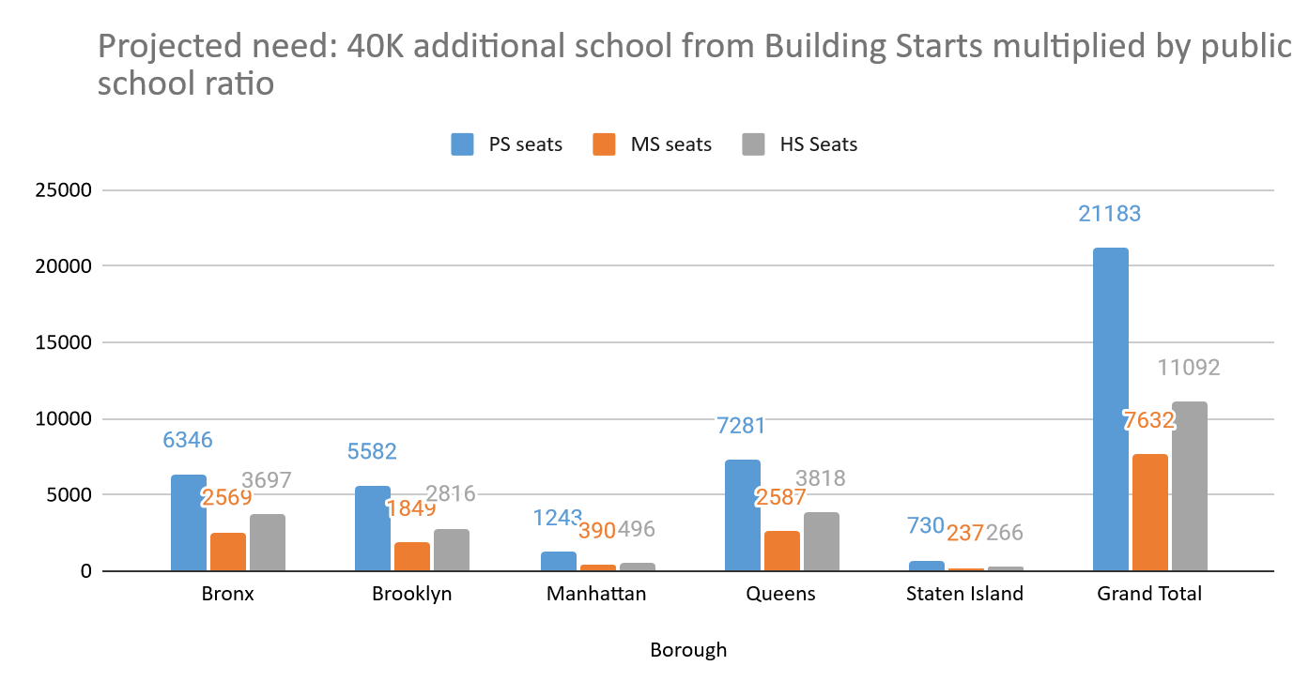
Another ~40K seats may be needed from new residential development 2020-2029 (Housing start data 6/2020; multiplier based on 2010 census data)

Slide 30
Reforms also need to be considered to admissions/ zoning policies
SCA in general does not plan to build any schools where district or subdistrict AVERAGE utilization is under 100% except in rare occasions -Yet many schools in same district may be at 50% utilization or less while others over 150%
Accelerating rezoning of elementary schools and revamping MS & HS admissions to more equitably allocate enrollment across all schools would lower # new seats needed
This would also likely create more diversity across system as most overcrowded schools are those with the highest white/Asian populations, and those most underutilized tend to have highest Black/Hispanic population
More balanced enrollment across schools would also provide more sustainable budgets for underenrolled schools

Slide 31
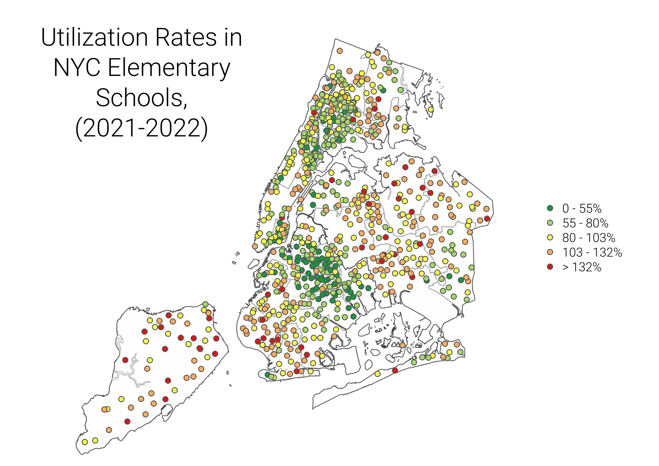
We have interactive school overcrowding map at https://tinyurl.com/NYCschoolovercrowdingmap

Slide 32
Other steps DOE could take to create more space for smaller classes
There are more than 34,000 empty 3K and preK seats in CBOs and DOE pre-K centers, according to data released last week
Moving 3K and preK classes out of overcrowded elementary schools into neighborhood CBOs would benefit parents and children, since many CBOs have longer hours and higher quality ratings
This would also create more space in elementary schools and provide CBOs with more sustainable budgets –over the short and long term
Merging co-located schools and moving charter schools out of DOE buildings would also help in terms of funding and creating additional space for smaller classes.

Slide 33
SCA/DOE claims they’re building sufficient seats but haven’t provided evidence to support this
Local Law 167 (2018) requires DOE to provide transparent methodology and data on which seats needs estimates made by 2019. None of this has happened.
Enrollment projections do not include 3K, D75, D79 or co-located charter school students, all of whom taking up increased space in our schools, and no sub-district trends are available.
Seats listed under “seats needed” in capital plan STILL do not differentiate elementary vs MS needs; and IS vs HS seats; and housing start data is from 6/2020; with multiplier based on 2010 census data;
FAILED!
Notes:
SCA/DOE claims they’re funding all seats necessary but not complying with 2 important laws requiring more transparency and efficiency in school construction
Local Law 167 passed in 2018 requires them to make methodology for projecting need for new school seats more transparent, as well as provide these estimates by grade level, but this has not been done.
Local Law 168 passed in 2018 created a Task Force for School Siting to report and analyze identify sites where new schools could be built, including all empty lots owned privately and by the city- & privately-owned lots.
The Task Force met twice, released a 2-pg report & a spreadsheet that ruled out hundreds of city-owned sites for unclear reasons, and never reported on privately owned sites.

Slide 34
More issues with lack of compliance with Local Law 167
Contrary to requirements in the law, no methodology is described, instead says SCA says they draw on various data sources including above, and then uses “qualitative analysis” and “various strategies to address need.”
None of the underlying data or results posted has been updated since class size law passed in June 2022.
http://www.nycsca.org/community/capital-plan-reports-data as of 7.4.23.

Slide 35
DOE also in non-compliance with Local Law 168
Local Law 168 (2018) created a Task Force for School Siting to identify sites where new schools could be built, including all city-owned & privately-owned empty lots
The Task Force met only twice, released a 2-pg report with no input from City Council & parent members
Through FOIL we received a spreadsheet that ruled out hundreds of city-owned sites for unclear reasons, and never reported on suitability of 22,065 privately-owned sites.
FAILED!

Slide 36
Issues with the DOE draft “plan”
Not a single penny of additional $500M in CFE/C4E funds to be allocated specifically for class size reduction or more staffing, though 4,000 K12 full-time teaching positions have been eliminated over last 5 years with another 800 or so to be eliminated according to new budget.
More than 300K students crammed into overcrowded schools this year
DOE claims will cost $30B-$35B to provide enough space but doesn’t explain why they are cutting new capacity $7.8B by $2.3 B & 22,000 seats.
Takes at least 5 years to site & build schools so this cannot be put off till next year or beyond unless we risk putting in hundreds more trailers.
DOE “plan” includes no changes in zoning or enrollment to cap overcrowded schools at lower levels

Slide 37
Only one DOE promise for next year in its draft class size plan
DOE draft plan contains NO proposed changes to policies or practices for next year except for one:
Ensure that schools with classrooms that currently meet the class size mandate have appropriate funding to continue to maintain these class sizes in SY23-24.
Yet there is no information in the plan or otherwise on how the DOE is planning to ensure this, and we have already heard from some schools where classes made the class size caps in the law but will not make the caps next year.
These schools appear to have received no special funding or support to prevent class sizes from further increasing.

Slide 38
Education budget for next year again claims NOT to cut school budgets, but is this true?
DOE overall budget flat for next year despite $500M in additional state foundation funds – the final tranche of 3-year phase-in of $1.3B
DOE claims no cuts to school initial budgets compared to this year’s initial budgets, though mid-year adjustments (i.e. funding givebacks) may be required.
In addition, 1/3 of schools will see cuts in Fair Student Funding – primary source of funding for teachers and other staffing.
Schools with higher percentages of students who are Black, Hispanic, have disabilities and in poverty are more likely to see FSF cuts.
Already we’ve heard of some schools forced to excess teachers; and according to Council analysis, this budget will lead to the elimination of over 800 full-time teaching positions, many of them unfilled.

Slide 39
Next steps?
Questions about presentation?
Who should we invite to our next committee working group meeting July 13? SCA/ DOE space planning/ census bureau/ others?
Should we provide list of questions to the speakers in advance to give them time to prepare & have less excuse if they come without answers?
What else?

