Slide 1
Parent Action Conference What additional funds will be available to NYC schools starting next year & what has been proposed?
May 22, 2021

Slide 2
NYC schools due to receive more than $8 billion in additional state & federal aid over next 2-3 years
Dec. 2020 – Congress approves $2.2 B in additional aid for NYC schools via the Coronavirus Response and Relief Supplemental Appropriations (CRRSA) to help them deal with the additional costs of pandemic.
Feb. 2021 – America Cares Rescue Act (ACRA) includes about $4.8 B in extra funds for NYC schools over the next two- three years, to help them reopen safely and well with additional learning support.
April 2021 – State budget includes $530 M in full foundation aid to NYC schools next year, increasing to about $1.3 B over three years, to fulfill the goals of the Campaign for Fiscal Equity lawsuit.

Slide 3
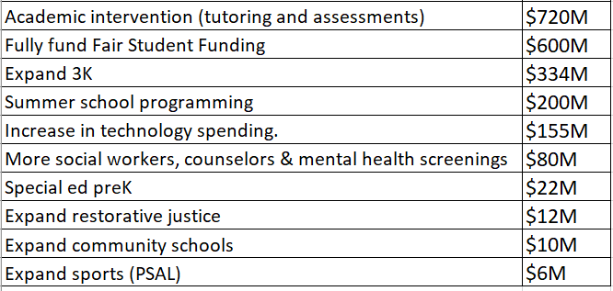
What has the Mayor/DOE proposed to do with additional funding?

Slide 4
Which of the NYC Council priorities was left out?
Class size reduction (Council has proposed at $250M)
Additional special education teachers and therapists
Citywide Literacy Curriculum & training ($50M)
Ensure every School has a Nurse (Council estimates at $10M)
Ensure every School has a social worker (77 schools will not)
Support and enhance LGBTQ Curriculum ($2M)
Expand Immigrant Family Engagement ($8.5M)
Pay parity for special ed preK teachers

Slide 5
Key issue in the NY Appeals Court CFE decision in 2003 was that class sizes were too large to provide NYC students w/ their right to a sound basic education
Plaintiffs presented measurable proof, credited by the trial court, that NYC schools have excessive class sizes, and that class size affects learning.”
“Plaintiffs' evidence of the advantages of smaller class sizes supports the inference sufficiently to show a meaningful correlation between the large classes in City schools and the outputs…of poor academic achievement and high dropout rates.”
[T]ens of thousands of students are placed in overcrowded classrooms …and provided with inadequate facilities and equipment. The number of children in these straits is large enough to represent a systemic failure.”

Slide 6
And yet class sizes have not diminished since the Court of Appeals issued their decision in 2003! In fact, in the early grades they have significantly increased.

Slide 7
LT trend average class size in grades K-3 1998-2019

Slide 8
LT trend average class size in grades 4-8 1998-2019

Slide 10
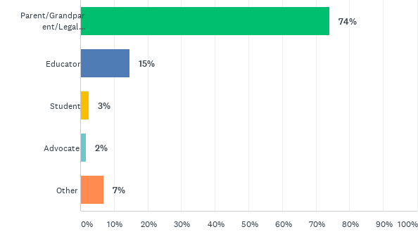
Survey Results: How To Spend Billions of Federal and State School Improvement Funds
April 30 – May 21, 2021
116 respondents, 74% parents

Slide 11
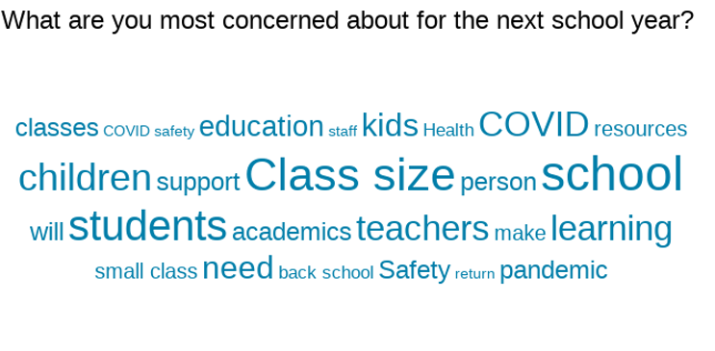

Slide 13
We offered 14 potential options for investing this new funding

Slide 14
Now we’ll go into break-out groups and reconvene at 12: 30 PM
Elementary schools (Leonie & Margaret)
Middle and High Schools (Camille and Anna Minsky)
Students w/ disabilities (Paulette and Naomi)
English Language Learners (Naila)
Student group led by Teens Take Charge

Slide 15
Call to action!
Final city budget to be negotiated in June
Sign our petition to the Mayor for smaller classes https://tinyurl.com/classsizepetition2021
Sign up for the CSM mailing list to be updated https://tinyurl.com/Classsizenewsletter

Slide 16
City Council hearings on Budget on Tuesday
Will be held Tuesday May 25 starting at 10 AM
Sign up to testify live via Zoom up to 24 hours in advance, https://council.nyc.gov/testify
Or email it to testimony@council.nyc.gov up to 72 hrs after the close of the hearing

Slide 17
Bill in NYC legislature to renew NYC’s obligation to lower class size
Bill in Senate introduced by Sen. Robert Jackson, original CFE plaintiff S.6286 and in Assembly by AM Jo Anne Simon A7447
Bill would update and renew NYC”s obligation to lower class size in all grades by amending and updating C4E law
You can call your legislators to ask them to support the bill and send an email at: https://tinyurl.com/letterforclasssize

