Slide 1
Class Size Trends Citywide & in District 27 plus school overcrowding
Leonie Haimson & Peter LaChance
Class Size Matters
1/27/20
www.classsizematters.org
Info@classsizematters.org

Slide 2
What are the UFT contractual class sizes limits?
25 students per class in Kindergarten
32 students per class in elementary grades
In Title I middle school, 30 students per class, 33 in non-Title I MS
34 students per class in high school core academic classes
These class size caps have not been lowered in 50 YEARS!
Even so, hundreds of classes violate the union contractual caps each year.

Slide 3
*the lower figure uses 33 students as class size cap for non-Title I MS; the higher figure uses 30 as cap for Title I MS.

Slide 4
In 2007, NYS Legislature passed a new law called the Contracts for Excellence (C4E)

Slide 5
C4E law states that in return for millions in new state funding, NYC has a legal obligation to: 1. Spend the funds to improve school conditions in six specified areas. 2. Create a plan to gradually reduce class sizes in all grades over five years in three grade spans. 3. In 2007, NYC submitted a 5-yr plan to reduce class sizes to no more than 20 in grades K-3; 23 in grades 4-8 and 25 in core HS classes. 4. Yet instead of decreasing, class sizes increased sharply, starting in 2008.

Slide 9
But average class sizes only tell part of the story! The total number of students in classes of 30 or more citywide has also increased since 2007.

Slide 10
*Only HS students in social studies classes included to avoid double counting

Slide 17
Class size lawsuit filed in state court
In July 2017, CSM along with 9 NYC parents & AQE filed a complaint with the State Education Commissioner to demand they enforce the C4E and require NYC to lower class size.
In April 2018, after the Commissioner ruled against us, we followed up with a lawsuit vs. the city and the state in the NYS Supreme Court.
Though Judge Henry Zwack ruled that the Commissioner’s decision to allow NYC to increase class size should be given deference, we appealed the case to the Appellate Court in May 2019.
Hearings were held at the NY Appellate Court in Albany on Monday, January 13, 2020.
.

Slide 18
School overcrowding also an issue in many districts including D27
C4E regs require capital plan be aligned with DOE’s class size reduction plan.
Data in Blue Book shows that last year, there were 524,467 students in NYC schools at 100% utilization or more.
This is 53.2% of all NYC students.
Though in some districts, there would be space to lower class size right now.

Slide 21
Despite overcrowding and large class sizes, the Capital Plan decreased funded seats in many districts between Feb. 2019 and Nov. 2019
The Nov. 2019 proposed amendment to the Five-Year Capital Plan appears to increase by 572 funded seats but actually eliminates 1,772 seats for Districts 1-32 and HS.
2,344 seats for D75 special education are now included in the total, though not in the Feb. 2019 Capital Plan.
D27 gained an extra 20 funded seats in the new plan to make a total of 1776 seats.
All the D27 seats are apparently still unsited – as not listed “in process.”

Slide 22
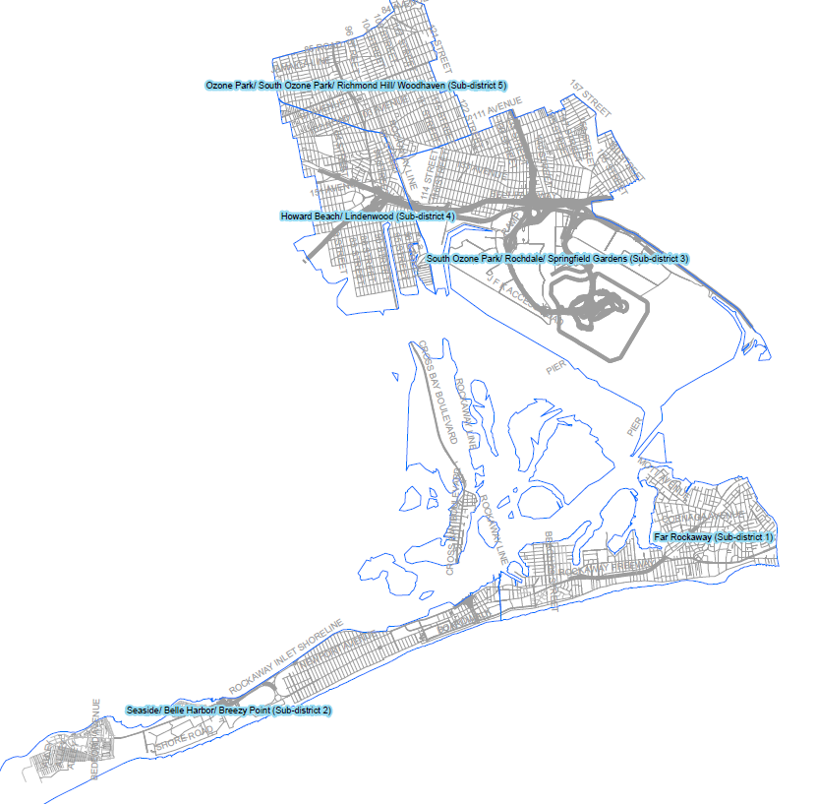
There are 5 subdistricts in D27, but only 2 have seats in capital plan
Ozone Park/ South Ozone Park/ Richmond Hill/ Woodhaven (1300 seats)
Howard Beach/ Lindenwood (0 seats)
South Ozone Park/ Rochdale/ Springfield Gardens (0 seats)
Far Rockaway (0 seats)
Seaside/ Belle Harbor/ Breezy Point (476 seats)

Slide 23
What did the Chancellor say at your town hall meeting on Jan. 13?
According to Queens Courier, Chancellor Carranza said that “in the $16 billion five-year capital plan that we just had approved this past school year, there is funding for 54,000 new seats in new schools and almost half of them are in Rockaway, Queens.”
There are actually 57,489 seats in the new capital plan
Of these, 1776 seats are in D27, 3% of the total seats.
Only 476 seats are in the Rockaways – broadly defined, in the Seaside/Belle Harbor/Breezy Point subdistrict, and none for Far Rockaway.
Instead of nearly half, that represents less than 1%.

Slide 24
School siting taskforce created by Local Law 168
Met only twice with no input from parent or City Council members.
Produced a 2-page report which we FOILed, along with two spreadsheets.
Out of 29,509 sites investigated, only two locations will be investigated as sites for new schools, one in D21 and the other in D23.
Sites were removed from consideration for a variety of reasons, including being underwater, not meeting size requirements, not needed, or not being city-owned.
The SCA did yet not review over 75% (22,000+) of identified empty lots because they’re not City-owned, claiming that these will be looked at “in the near future.”

Slide 25
D27 School Sites
185 sites in D27 were investigated, and all were deemed unacceptable for the following reasons:
Land underwater, waterfront, etc.
Other excuses used: either “All seats sited” or “no funded seats”
But there are 1776 seats in capital plan for D27 - & NONE of them are yet sited, according to the capital plan.

Slide 26
What are we doing?
We are urging the City Council to allocate dedicated funding for class size reduction, especially in struggling schools and in the lower grades.
We will again push for this in next year’s budget.
Please join our campaign by passing a resolution for funds to be allocated towards reducing class size
And contact your Council Members to support this effort.

Slide 27
How you can help ?
Contact your state legislators urging them to amend the law to relieve DOE’s obligation to provide space for charters in public schools or pay for their rent in private buildings.
Join us in advocating for specific funding be allocated for class size reduction in next city budget and that the capital plan be expanded.
City Hall Rally and hearings on class size to come.
We’re co-sponsoring a Parent Action Conference with NYC Kids PAC on March 7, 2020 with panels & workshops to explore these issues and more.
Sign up for our newsletter for updates at www.classsizematters.org

