Slide 1
Class Size Trends Citywide & in District 12 plus school overcrowding
Leonie Haimson & Peter LaChance
Class Size Matters
2/13/20
www.classsizematters.org
Info@classsizematters.org

Slide 2
What are the UFT contractual class sizes limits?
25 students per class in Kindergarten
32 students per class in elementary grades
In Title I middle school, 30 students per class, 33 in non-Title I MS
34 students per class in high school core academic classes
These class size caps have not been lowered in 50 YEARS!
Even so, hundreds of classes violate the union contractual caps each year.

Slide 3
*the lower figure uses 33 students as class size cap for non-Title I MS; the higher figure uses 30 as cap for Title I MS.

Slide 4
In 2007, NYS Legislature passed a new law called the Contracts for Excellence (C4E)

Slide 5
C4E law states that in return for millions in new state funding, NYC has a legal obligation to: 1. Spend the funds to improve school conditions in six specified areas. 2. Create a plan to gradually reduce class sizes in all grades over five years in three grade spans. 3. In 2007, NYC submitted a 5-yr plan to reduce class sizes to no more than 20 in grades K-3; 23 in grades 4-8 and 25 in core HS classes. 4. Yet instead of decreasing, class sizes increased sharply, starting in 2008.

Slide 9
But average class sizes only tell part of the story! The total number of students in large classes citywide has also increased since 2007.

Slide 10
*Only HS students in social studies classes included to avoid double counting

Slide 14
Class size lawsuit filed in state court
In July 2017, CSM along with 9 NYC parents & AQE filed a complaint with the State Education Commissioner to demand they enforce the C4E and require NYC to lower class size.
In April 2018, after the Commissioner ruled against us, we followed up with a lawsuit vs. the city and the state in the NYS Supreme Court.
Though Judge Henry Zwack ruled that the Commissioner’s decision to allow NYC to increase class size should be given deference, we appealed the case to the Appellate Court in May 2019.
Hearings were held at the NY Appellate Court in Albany on Monday, January 13, 2020.

Slide 15
School overcrowding also an issue in many districts, including D12
C4E regs require capital plan be aligned with DOE’s class size reduction plan.
Data in Blue Book shows that last year, there were 524,467 students in NYC schools at 100% utilization or more.
This is 53.2% of all NYC students.
Though in some districts, there would be space to lower class size right now.

Slide 18
Despite overcrowding and large class sizes, the Capital Plan decreased funded seats in many districts between Feb. 2019 and Nov. 2019
The Nov. 2019 proposed amendment to the Five-Year Capital Plan appears to increase by 572 funded seats but actually eliminates 1,772 seats for Districts 1-32 and HS.
2,344 seats for D75 special education are now included in the total, though not in the Feb. 2019 Capital Plan.
D12 gained an extra 132 funded seats in the new plan to make a total of 1,066 seats.
All the D12 seats are apparently completed or in progress.

Slide 20
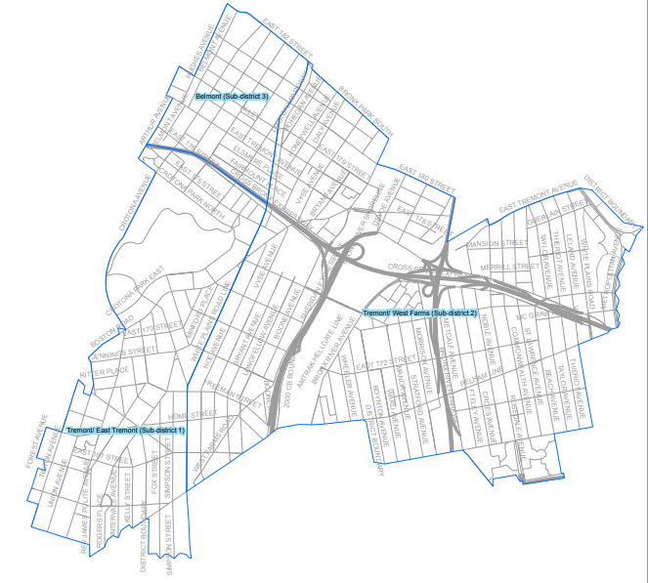
There are 3 subdistricts in D12, but only 1 has seats in capital plan
Tremont/East Tremont (0 seats)
Tremont/West Farms (1,066 seats)
Belmont (0 seats)

Slide 21
What are we doing?
We are urging the City Council to allocate dedicated funding for class size reduction, especially in struggling schools and in the lower grades.
We will again push for this in next year’s budget.
Please join our campaign by passing a resolution for funds to be allocated towards reducing class size
And contact your Council Members to support this effort.

Slide 22
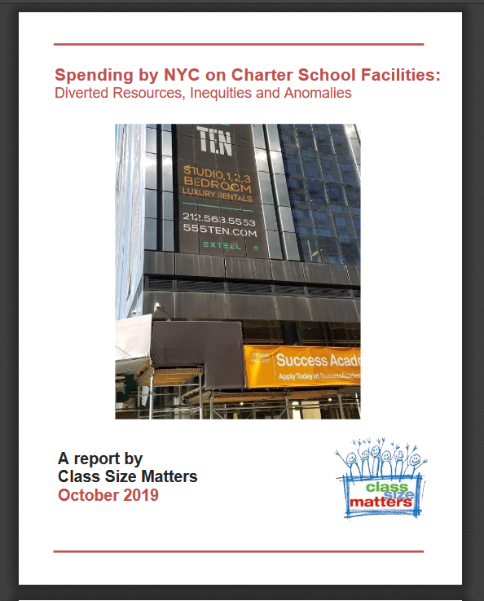
We released a report on charter facility funding in October 2019.
State law passed in 2010 requires matching funds for facility upgrades for public schools co-located with charter schools, for every expenditure by charters for facility renovations over $5000.
We found that FY 2014 to FY 2019, about $22.1 million in charter school expenditures on facility upgrades were not matched in the public schools that shared their buildings, a shortfall of about 14%

Slide 23
Notes:
Report Figure 3

Slide 25
In 2014, the state passed a law stating that NYC must either provide charter schools space in public school buildings or help them pay for private space
NYC is the only district in the state and the country with this legal obligation.
We found that the cost of leasing private buildings for charters or providing them a per-student subsidy to help with their rent has risen sharply, and was over $100 M last year;
This amount, if used to finance the school capital plan, could fund a substantial increase in school seats to ease overcrowding.

Slide 26
Contact your state legislators urging them to amend the law to relieve DOE’s obligation to provide space for charters in public schools or pay for their rent in private buildings.
Join us in advocating for specific funding be allocated for class size reduction in next city budget and that the capital plan be expanded.
City Hall Rally and hearings on class size to come.
We’re co-sponsoring a Parent Action Conference with NYC Kids PAC on March 7, 2020 with panels & workshops to explore these issues and more.
Sign up for our newsletter for updates at www.classsizematters.org
How you can help

