Slide 1
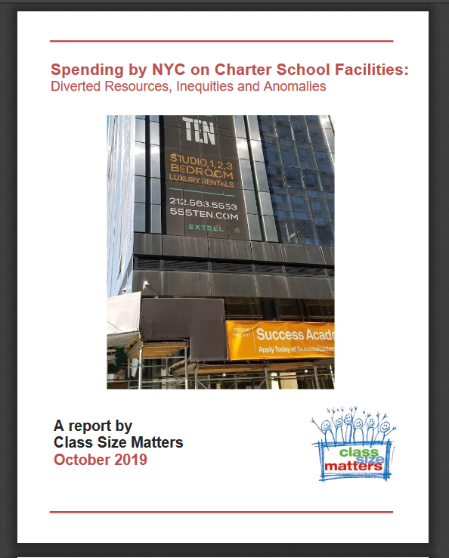
NYC spending on Charter School Facilities
Leonie Haimson
Class Size Matters
www.classsizematters.org
Jan. 7, 2020

Slide 2
Total NYC spending = matching funds to co-located public schools + charter subsidies for space
We estimate that the total amount of public funds spent from FY 2014 to FY 2019 on matching funds for facility upgrades for co-located public schools and for charter school lease assistance reached $377.5 million.
This includes $87.6 million in projected state reimbursements for charter lease subsidies
The cost is rapidly growing every year and totaled more than $125 M in FY 2019
$100M last year on rental assistance to charters alone.

Slide 3
Matching funds for co-located public schools
NY State law passed in 2010 that matching funds should be provided to public schools co-located w/charters that spend over $5000 on facility upgrades per year.
The amount spent by the charter school is supposed to be matched for each public school that shares the same building; and often there is more than one co-located public school per building.
DOE matching funds for public schools co-located with charter schools totaled $20 to $25 million per year between FY 2014 and FY 2019, for a total of $131.6M.
Yet during that period, total of $22.1 million in charter school expenditures on facility upgrades were not matched to the public schools that shared their buildings, a shortfall of about 14%
Total spending AND shortfall growing each year

Slide 4
Notes:
Report Figure 3

Slide 5
Notes:
Report Figure 2

Slide 10
The three public schools that lacked the most in matching funds all serve a very high needs population: Mickey Mantle School (M811) a D75 school enrolling students with multiple disabilities, including autism, emotional/behavioral difficulties and/or communication disorders, located in 2 in Harlem lacked $1.5 million in matching funds from FY 2014 to FY 2019. P.S 368 (K368), a D75 school located in two sites in Brooklyn, serving students with autism and emotional difficulties, lacked $1.2 million in matching funds. Mosaic Preparatory Academy or P.S. 375 (M375), a zoned elementary school lacked $913,000 in East Harlem in an area that includes 3 public housing complexes over this period.
15 co-located public schools deprived the most of matching funds all co-located with Success Academy charter schools.
Notes:
This likely reflects the high level of annual spending made by Success to upgrade its facilities.

Slide 11
Why does the DOE not fully match the funds spent?
DOE may interpret the law meaning they don’t have to match individual projects undertaken by charters that cost under $5000, even if the total amount spent on facility upgrades per year exceeds that amount.
But that interpretation doesn’t seem consistent with the language of NY Education Law 2853 or Chancellor’s regs which match the law exactly.
“For any capital improvements or facility upgrades in excess of five thousand dollars that have been approved by the chancellor, regardless of the source of funding, made in a charter school that is already co-located within a public school building, matching capital improvements or facility upgrades shall be made in an amount equal to the expenditure of the charter school for each non-charter public school within the public school building within three months of such improvements or upgrades”

Slide 12
Also this interpretation of law doesn’t make sense given huge disparities in some cases
Take example of Mosaic Preparatory Academy, public school co-located with Success Academy Harlem 3.
Lacked $662,315.17 in matching funds spent by Success Academy in FY 2019 alone.
Even if DOE didn’t believe it had to match each individual project under $5,000, that would have to mean that the co-located charter would have had to commission at least 132 separate renovation projects, each costing less than $5,000, to account for all the missing matching funds.

Slide 13
Also – why doesn’t DOE turn down more requests?
State law requires that the Chancellor must provide prior approval for any charter school renovations that cost more than $5,000.
Yet both KIPP and Success Academy renovate nearly every one of their charter schools every single year (100% and 99% respectively)
Success spends a significant amount each year – an average of $270,000 each year on each of its schools; KIPP $188,000 each year.
There is no evidence that the DOE has ever turned one of their requests

Slide 14
In 2014, the state passed a law stating that NYC must either provide charter schools space in public school buildings or help them pay for private space
NYC is the only district in the state and the country with this legal obligation.
We found that the cost of leasing private buildings for charters or providing them a per-student subsidy to help with their rent has risen sharply, and was over $100 M last year;
This amount, if used to finance the school capital plan, could fund a substantial increase in school seats to ease overcrowding.

Slide 15
Should NYC be obligated to pay for private space for charters at all?
The cost of lease subsidies and direct leases for charter schools was more than $100M per year last year and is still growing fast, as many authorized charters have yet to open, others are still growing and the per student amount, linked to per student expenditures, will also increase over time.
NYC is the only school district in the nation required by law to cover any of the cost of private space for new and expanding charter schools.
The NY State Legislature should consider if the state law requiring the DOE to pay for the cost of private space for charter schools should be amended or rescinded.
NYC also the only district in the state that doesn’t received any “transitional aid” for the growing cost of charter schools per-student tuition.

Slide 16
Lease Subsidies expense growing fast
132 charter school facility appeals made from FY 2015 to FY 2019,only 5 dismissed by SED Commissioner & 2 of these later prevailed.
In FY 2019, DOE is projected to spend about $83.6 million in lease subsidies for charter schools, with an estimated $50 million of that reimbursed by the state
The average projected amount received per school via lease subsidies was about $220,000 in FY 2015 grew to $880,000 in FY 2019
Cost is rapidly increasing each year, as is the cost of leases directly held by DOE for buildings housing charter schools.

Slide 17
8 Charters receive lease subsidies though their buildings owned by related parties
DOE is providing per student lease subsidies for eight charter schools whose facilities are owned by related parties
This means the building is owned by their charter management organizations or an affiliated LLC or foundation.
The total for such expenditures amounts to about $14.8 million in DOE expenditures since FY 2015

Slide 18
Examples
DOE spent $2.2 million for two Success Academy charter schools in FY 2019 located in Hudson Yards complex on the west side of Manhattan, the most expensive real estate development in NYC. Yet Success CMO purchased space for $68M in 2016, with $20M paid for by Robertson Foundation.
DOE paid $461,965 in lease subsidies in FY 2019 towards the rental costs of Beginning with Children II charter school in Brooklyn, though Beginning with Children Foundation bought its building for $10 in 2017 from the Pfizer Corporation.
Since FY 2015, the DOE has paid $3.2M for lease subsidies to Harlem Village Academy – West (M335). Building purchased in 2012 by HVA 124 LLC for $13M, of which CMO is sole member – before charter amendment passed. $25M for building & renovations donated by Jonathan Gray COO of Blackstone.

Slide 19
Yet more examples
Since FY 2015, the DOE has provided $2.1 million in lease subsidies to Harlem Children's Zone Promise Academy II Charter School (M341) though building is owned by “Rheedlen 125th Street LLC” since 2000, a subsidiary of Harlem Children Zone network and their sole member.
Family Life Charter Schools (FLACS) received $862,696 from DOE in lease subsidies in FY 2018. School founded by Latino Pastoral Action Center (LPAC), headquartered in the same building and owned by LPAC.
East Harlem Scholars Academy (M518) has received $3.1M; building owned by “East Harlem Center, LLC” wholly owned subsidiary of East Harlem Tutorial Program, the charter school’s CMO.

Slide 20
More examples
Metropolitan Lighthouse Charter School in the Bronx has received $2.6M in lease assistance from DOE since 2017; school is sole member of “180 W. 165th Street LLC”, which bought the building with low-interest and tax-exempt financing of $25.7M from Build NYC Resource Corporation.
The DOE paid lease assistance to DREAM Charter School for FY 2018, amounting to $433,630 for a 9th grade level expansion.
Yet DOE already contributed $32.5M for the school’s construction, according to the 2010-2014 capital plan -- within a building owned by NYCHA.
We couldn’t tell from the schools’ financial statements what rent, if any, they pay for the space.

Slide 22
More analysis needed on the following issues: 1. Is the 72% increase in per-student subsidy for charter rent since 2016 reasonable? 2. Charter law states that the “lease subsidy” must be equivalent to the lesser of per pupil subsidy or total base rent. Yet in FY 2019, DOE data seems to show that 39 charter schools were projected to receive lease subsidies amounting to more than listed base ren . 3. DOE directly leasing 8 private buildings housing 9 charter schools; if the city made charters go through appeal process to obtain per student subsidies DOE would have spent $9.5M less – esp. given the state now provides 60% of the cost.

Slide 23
Finally, should DOE be required to provide lease subsidies for charters whose space is owned by related parties?
Is self-dealing is involved in any of these cases, and whether the charter school is paying more than fair-market value to its related CMO or other organization?
Did State legislature intended for taxpayer funds to be expended to cover the cost of buildings owned directly by the CMO or related organizations, and if not, what should be done as a result.

