Slide 1
Class size and overcrowding trends Citywide and District 6 data
Leonie Haimson
Class Size Matters
www.classsizematters.org
12.3.18

Slide 2
DOE released class sizes for NYC public schools on November 15, 2018.
Citywide, District and class sizes by school as of October 31, 2018 posted by here: https://infohub.nyced.org/reports-and-policies/government/intergovernmental-affairs/class-size-reports
What slides do not show: the Contracts for Excellence law passed in 2007 obligated NYC to reduce class size in all grades & DOE submitted plan approved by state to lower class sizes to no more than 20 on average in K-3; 23 on average in 4th-8th and 25 in HS.
Yet class sizes increased substantially since then. Last year we along with 9 NYC parents filed a lawsuit vs State and City on this issue.
Judge Henry Zwack held that DOE didn’t violate the C4E law by allowing class sizes to increase, but his decision didn’t touch on any of the facts or allegations in the case and we are going to appeal that decision.

Slide 3
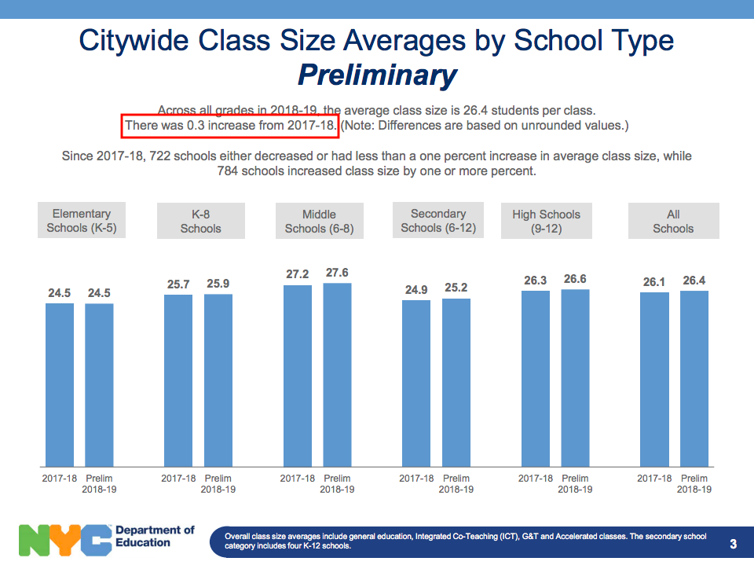
DOE slide #3: Average class size citywide increased on average by 0.3 to 26.4 students per class this fall

Slide 4
Our analysis
We analyze and compute average class sizes at the three grade levels C4E law pertains to Grades K-3, 4-8, and HS.
We compare the data in the DOE annual Nov. 15 class size reports to previous years, since 2007.

Slide 5
D6 K-3 class Sizes fell this year but still 6% higher than in 2007 & far above C4E levels Citywide K-3 class sizes fell slightly but still 14% larger than in 2007

Slide 6
D6 4-8th class size increased slightly this year –& remain above C4E levels Citywide class sizes remained same – 6% above 2007 levels

Slide 7
Average HS class sizes citywide in 2018 declined slightly from last year but remain above 2007 levels

Slide 8
Reason for average class size changes in D6 from 2007 to 2018
K-3 (Fewer Sections per Student)
Total # of sections decreased from 399 to 260 (-35%)
Total enrollment decreased from 8,385 to 5773 students (-31%)
Results in increase from 21 students per Class to 22.2 students per class
Grades 4th - 8th (More Sections per Student)
Total # of sections decreased from 462 to 301 (-34.8%)
Total enrollment decreased from 11,580 to 7,502 students (-35.2%)
Results in slight decrease of 25.1 students per class to 24.9 students per class

Slide 9
What these class size averages do not show slide
There are extreme disparities in class size across the city.
The number of students in very large classes has grown sharply since 2007 in grades K-8.

Slide 10
Citywide at least 336,165 students are in very large classes of 30 or more in fall 2018 14% of K-3 students, 36% of 4th-8th gr students & 57% of all HS students)

Slide 11
Percent students in classes of 30 or more

Slide 12
The number of Kindergarten students in classes of 25 or more citywide has increased by more than 53% (5,893 students) since 2007

Slide 13
Number of 1st - 3rd graders in classes of 30 or more has grown by nearly 3000%

Slide 14
Number of 4th-8th graders in classes of 30 or more has grown by 40%

Slide 15
Every year since 2014, DOE has promised SED that they would focus their C4E class size efforts on Renewal schools
Yet, none of the fifty remaining Renewal schools capped class sizes this fall at C4E goals of 20 in K-3, 23 in grades 4th-8th, and 25 in HS core classes
In 2018, nearly three quarters (74%) Renewal schools have maximum class sizes of 30 or more.
Between November 2014 to November 2018, 36% did not reduce class size by even a fraction of a student.
Over that same period, fewer than half (48%) decreased average class size by one student of more.
Our analysis showed that those Renewal schools that did offer small classes were far more likely to have improved student outcomes, as measured by DOE’s impact score on the performance dashboard.

Slide 16
Scope of School overcrowding is enormous
43% NYC schools were overcrowded last year according to DOE data
About 575,000 students (56% of total) were enrolled in overcrowded schools
About 350,000 (68% of total) elementary students enrolled in overcrowded schools
About 50,000 (33% of total) middle school students enrolled in overcrowded schools
About 175,000 (49% of total) HS students enrolled in overcrowded schools
Data source: Schools at or above 100% according to SCA “Blue Book” 2016-2017

Slide 17
Why are our schools overcrowded?
Bloomberg claimed to have created 100,000 new seats between 2004 and 2013
Yet only 45,000 new NET seats created if seat loss taken into account
About 55,000 seats were lost due to lapsed leases, elimination of TCUs (trailers), annexes, and mini- buildings
Also, enrollment grew fast especially at the elementary school level
Analysis available in our Seat Loss report, available online at www.classsizematters.org

Slide 18
New proposed five-year Capital Plan
56,917 Seats funded in new proposed 2020-2024 Capital Plan proposed in Nov. 2018 compared to 44,628 in current five year plan 2014-2019 (1600 for design only)
But nearly half or 23,284 seats are rolled over from current Capital Plan (33,633 new seats)
Funds about 69% seats necessary according to Nov. 2017 DOE identified seats need
Large variation across districts in the number and percent of seats funded compared to DOE’s estimate of need.
Brooklyn now most underfunded borough according to percent of unmet need for seats; Queens in total number of unfunded seats.
Source: 2020-2024 Capital Plan, Proposed November 2018

Slide 19
69% K-8 seats funded citywide compared to DOE Nov. 2017 Identified need. DOE says no need for seats in D6 Data: Nov 2018 capital plan

Slide 20
Yet District 6 is still an overcrowded district
District 6 Elementary Schools AVERAGE 106% overcapacity.
District 6 Middle Schools are at 78% capacity.
43% (17) of K-8 schools in District 6 are overcrowded (at or above 100% target utilization) with 7,113 students.
81 cluster rooms are missing from District 6 schools according to DOE’s utilization formula
DOE school capacity formula is not aligned to smaller classes in grades 4-12 & would tend to push class sizes even higher in these grades
Data source: 2016-2017 Blue Book.

Slide 21
17 Schools in District 6 at or over 100% - (Co-located Charters included) Data Source: 2016-2017 Blue Book

Slide 22
Problems with the housing starts & CEQR formula used to project enrollment
CEQR (City Environmental Quality Review) formula now disaggregated by district but not by sub-district or school zone. Doesn’t include 3K students or co-located charter school students.
Uses new multiplier disaggregated by district & based on more recent census data which increases the ratio for D6 from .12 to .16 for PK-5; and .04 to .06 for gr 6-8.
In 10 school districts, including D6, NO difference between housing start data for 5 yr and 10 yr projections.
Housing start data projects only 3,000 new housing units to be built in D6 between 2018-2024, which according to formula would creating a need for 618 seats – but this is less than projected to be built via Inwod rezoning.
Data source: NYC SCA, Projected new Housing starts used in 2018-2027 Enrollment projections, 2020-2024 capital plan, October 2018

Slide 23
Why no new seats needed in D6 according to DOE?
Declining enrollment in ES and MS – most likely because of increased charter school enrollment. (Charter enrollment up 2,397 while public school enrollment decreased by 2,369 between 2010-2015)
We believe DOE averages ES and MS capacity for its ID seats needs assessment in the capital plan -- and MS are under-enrolled in general according to Blue Book utilization formula.
Doesn’t take Inwood rezoning into account.
Doesn’t take need for smaller classes into account.
Doesn’t take 3K seats into account – and D6 due to get 3K in 2019-2020 school year.

Slide 24
New Inwood rezoning
Inwood rezoning plans for 4,397 additional units – >3,OOO new units projected for entire district by 2024 in housing start data (Oct. 2018.)
Inwood EIS (publ June 2018) projects this would generate up to 528 more elem school students, 176 MS students for total of 704.
Yet using new multiplier this housing would project need for 660 new ES plus 264 MS seats for a total of nearly 924.
One of zoned schools for area to be developed P.S. 278 – Paula Hedbavny to serve projected development sites already at 139% utilization
But EIS says no need for new schools by averaging utilization across entire sub-district where elementary schools average 98.7%; & assumes continued enrollment decline

Slide 25
Unified Inwood - local community group wrote its own comments to EIS
“Currently , our District 6 schools are both overcrowded and underfunded. There is no capacity for expansion or growth or increase in density.. Schools must be built first.”
EIS doesn’t take into account the no. of MS and HS students D6 “exports’ to other neighborhoods
DOE accounting of school space often includes cluster rooms as normal classroom space masking overcrowding.
Overcrowding is so severe in PS 314 that SETTS instruction for reading takes place in the landing space outside of the elevators.

Slide 26
Problems with school planning process
Thresholds in city planning process very high –new project has to be projected to increase school overcrowding by at least 5% to even consider need for new school --even where schools are already overcrowded
Averages utilization and enrollment trends across an entire sub-district rather than school zone or neighborhood based.
Doesn’t take into account projected enrollment growth of charter schools co-located in DOE buildings or 3K expansion
Doesn’t take account of need for smaller classes.
Enrollment projections and needs assessments are non-transparent, often unreliable and impossible to replicate

Slide 27
We need a new planning process for schools
Given rapid pace of development throughout the city, school overcrowding will become even worse
We need reforms so that schools are built along with new housing and not lagging years later & based on realistic 10-yr not 5yr projections
In most large states and districts, developers have to pay an “impact fee” to help fund new infrastructure including schools, but not in NYC

Slide 28
How can you help?
Join our mailing list at www.classsizematters.org or https://www.classsizematters.org/sign-up-for-our-newsletter/
Any questions? You can ask us at info@classsizematters.org

