Slide 1
Class size trends in NYC public schools
Leonie Haimson
Class Size Matters
www.classsizematters.org
2. 23. 18

Slide 2
Court of Appeals decision in CFE
In the landmark Campaign for Fiscal Equity case, the state’s highest court concluded in 2003 that smaller classes were needed for NYC students to receive their constitutional right to a sound basic education.
Yet class sizes are even larger now compared to when this decision was made, particularly in the early grades where research suggests it is most important to provide students with smaller classes.

Slide 3
Long-term class size trend since 1998 in grades K-3

Slide 4
Long term class size trend since 1998 in grades 4-8

Slide 5
DOE released class sizes for NYC public schools on November 15, 2018.
Citywide, District and class sizes by school as of October 31, 2018 posted by here: https://infohub.nyced.org/reports-and-policies/government/intergovernmental-affairs/class-size-reports
What slides do not show: the Contracts for Excellence law passed in 2007 obligated NYC to reduce class size in all grades & DOE submitted plan approved by state to lower class sizes to no more than 20 on average in K-3; 23 on average in 4th-8th and 25 in HS.
Yet class sizes increased substantially since then. Last year we along with 9 NYC parents filed a lawsuit vs State and City on this issue.
Judge Henry Zwack held that DOE didn’t violate the C4E law by allowing class sizes to increase, but his decision didn’t touch on any of the facts or allegations in the case and we are going to appeal that decision.

Slide 6
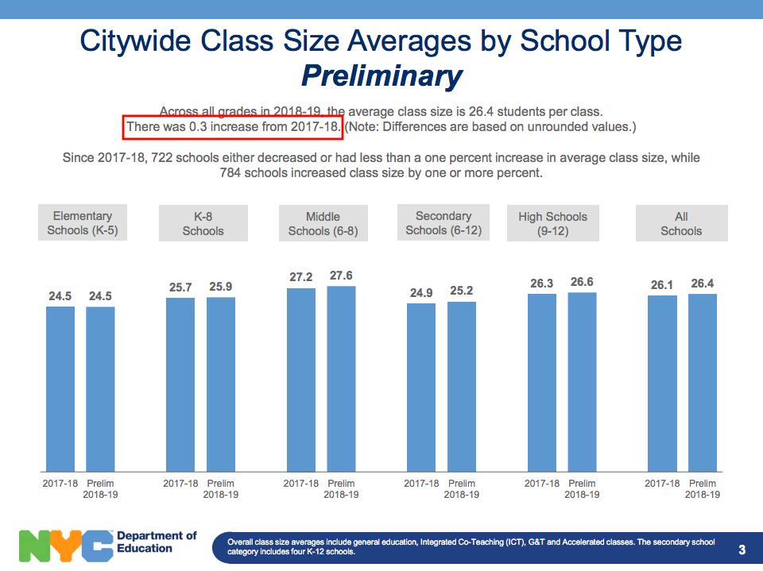
DOE slide #3: Average class size citywide increased on average by 0.3 to 26.4 students per class this fall

Slide 7
Our analysis finds something different.
We analyze and compute average class sizes at the three grade levels C4E law specifies: Grades K-3, 4-8, and HS.
We compare the data in the DOE annual Nov. 15 class size reports to previous years, since 2007 when the law was first passed.

Slide 8
Citywide K-3 class sizes fell slightly but are still 14% larger than in 2007

Slide 9
In 4th-8th grades, Citywide class sizes remained same – 6% above 2007 levels

Slide 10
Average HS class sizes citywide in 2018 declined slightly from last year but remain above 2007 levels

Slide 12
What these class size averages do not show
There are extreme disparities in class size across NYC neighborhoods and districts, with many students in classes of 30 or more.
The number of students in very large classes has grown sharply since 2007 especially in K-3.

Slide 13
Citywide at least 336,165 students are in very large classes of 30 or more this fall

Slide 14
Percent students in classes of 30 or more

Slide 15
The number of Kindergarten students in classes of 25 or more citywide has increased by more than 53% since 2007

Slide 16
Number of 1st - 3rd graders in classes of 30 or more has grown by nearly 3000%

Slide 17
Number of 4th-8th graders in classes of 30 or more has grown by 40%

Slide 18
Every year since 2014, DOE has promised SED that they would focus their C4E class size efforts on Renewal schools
Yet, none of the fifty remaining Renewal schools capped class sizes this fall at C4E goals of 20 in K-3, 23 in grades 4th-8th, and 25 in HS core classes
In 2018, nearly three quarters (74%) Renewal schools have maximum class sizes of 30 or more.
Between November 2014 to November 2018, 36% did not reduce class size by even a fraction of a student.
Over that same period, fewer than half (48%) decreased average class size by one student of more.
Our analysis showed that those Renewal schools that did offer small classes were far more likely to have improved student outcomes, as measured by DOE’s impact score on the performance dashboard.

