Slide 1
School Overcrowding & Class Size Citywide and in District 2 schools Presentation to CEC 2 Leonie Haimson and Sebastian Spitz Class Size Matters January 2018 info@classsizematters.org

Slide 2
This fall, District 2, average K-3 class sizes increased by .8, now .8 students above Citywide Average and 4.9 students above Contracts for Excellence goals set in 2007.

Slide 3
Average class size grades 4-8 remained at 27.5, .9 above Citywide average and 4.6 students above C4E goals

Slide 4
Citywide average HS class sizes stayed the same per class; and remain far above C4E goals

Slide 5
DOE promised State Ed in 2014 to focus on reducing class size at Renewal schools
Yet 42% of Renewal schools did NOT reduce average class sizes from 2014-2015 to 2017-2018
73% continue to have maximum class sizes of 30 or more in November 2017.
NO renewal schools have capped class sizes at C4E levels
There are NO Renewal Schools in District 2
Source: Preliminary NYC Class Size Reports, November 2014 and November 2017

Slide 6
Scope of school overcrowding enormous
43% NYC schools were overcrowded last year according to DOE data
About 575,000 students (56% of total) were enrolled in overcrowded schools
About 350,000 (68% of total) elementary students enrolled in overcrowded schools
About 50,000 (33% of total) middle school students enrolled in overcrowded schools
About 175,000 (49% of total ) HS students enrolled in overcrowded schools
Data source: Schools at or above 100% according to SCA “Blue Book” 2016-2017

Slide 7
Why are our schools so overcrowded?
Bloomberg claimed to have created 100,000 new seats between 2004 and 2013
Yet only 45,000 new NET seats created if seat loss taken into account
About 55,000 seats were lost due to lapsed leases, elimination of TCUs (trailers), annexes, and mini- buildings
Also, enrollment grew fast especially at the elementary school level
The following charts are from our recent Seat Loss report, available online at www.classsizematters.org

Slide 8
Enrollment grew faster than new seats in NYC elementary schools

Slide 9
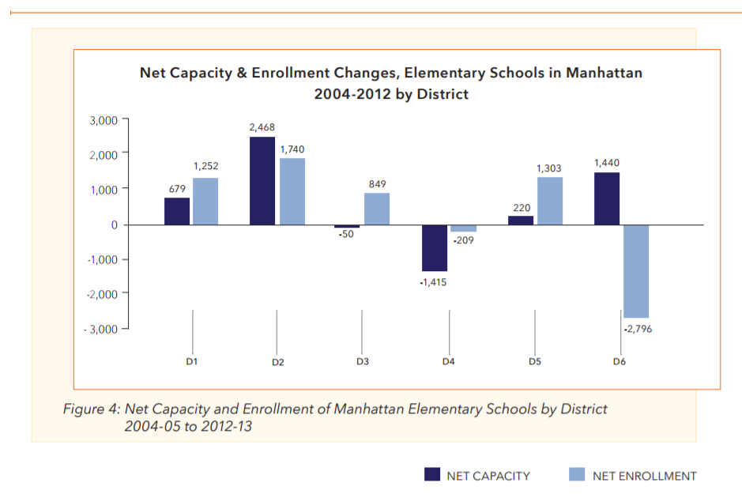
Elementary capacity increased faster than enrollment in District 2, unlike most other Manhattan Districts

Slide 10
While 45,000 net seats were gained citywide, nearly all were
filled by the increased number of charter school students

Slide 11
November 2017 DOE five-year capital plan still very underfunded
Funds fewer than 45,000 seats citywide – about half (54%) necessary to alleviate current overcrowding and accommodate enrollment growth, according to DOE estimates.
Only 37% of seats compared to DOE’s analysis of need have sites and are in process of scope and design.
There is a huge variation across districts in the number and percent of seats funded compared to DOE’s estimate of need.
Bronx is the most underfunded borough according to the percent of unmet need for seats; Queens in terms of total number of unfunded seats.

Slide 12
DOE Identified need for 83,056 K-8 seats citywide 3,232 seats in District 2 Nov. 2017 capital plan
Districts not included below have NO need for new seats according to DOE

Slide 13
54% K-8 seats funded citywide compared to DOE estimate of need
97.5% in District 2
Data: Nov. 2017 capital plan

Slide 14
District 2 Overcrowding (includes Charters in district buildings)
We think the need in District 2 is greater
55% (28) of K-8 schools in District 2 are overcrowded (at or above 100% target utilization)
54% or 14,063 K-8 D2 students are in overcrowded schools
119 cluster rooms are missing from District 2 schools according to DOE’s utilization formula
Data source: 2016-2017 Blue Book.

Slide 15
11 Districts between 99% - 80% Utilization, including D2 at 95% Data Source: 2016-2017 Blue Book

Slide 16
28 Schools in District 2 at or over 100% - Data Source: 2016-2017 Blue Book

Slide 17
More District 2 overcrowded schools (Co-located Charters included) Data Source: 2016-2017 Blue Book

Slide 18
Problems with the housing starts & CEQR formula used to project enrollment
CEQR (City Environmental Quality Review) formula based on census data 20 years old & hasn’t been updated since UPK implemented & preK expanded in DOE schools
In 20 of 32 school districts, NO difference between housing start data for 5 yr and 10 yr projections; predicts fewer than 2,000 new units to be built citywide 2019-2024, and not one in Brooklyn.
Five-year housing start data estimates 50,946 new housing units built in D2 between 2015-2019, but just 1044 in the following five years
Data source: NYC SCA, Projected new Housing starts used in 2016-2024 Enrollment projections, 2016-2029 capital plan, March 2017

Slide 19
Problems with school planning process
Thresholds in city planning process very high
A new residential project has to be projected to increase school overcrowding by at least 5% to even consider need for new school --even where schools are already overcrowded
Planning process does not take into account cumulative residential development – only considers each proposed project separately.

Slide 20
More reasons not to trust DOE’s need estimates
The DOE estimates also rely upon unreliable enrollment projections from consulting companies
The methodology DOE uses to incorporate all these unreliable components is non-transparent
DOE says they “overlay” projections from housing starts over consultant enrollment projections but unclear what this means
Result: we can’t replicate their projections using their own figures

Slide 21
Other problems with DOE seat needs assessments
They don’t account for rapidly expanding charter school population though most of these students attend schools in public school buildings
Claim to be neighborhood-based but define neighborhoods with extremely large areas
Don’t differentiate between the need for elementary and middle school seats
Are infrequently updated; for example, Feb. 2017 capital plan included DOE needs assessment from Jan. 2016

Slide 22
We need a new planning process for schools
Given rapid pace of development throughout the city, school overcrowding will become even worse
We need reforms so that schools are built along with new housing and not lagging years later & based on realistic 10-yr not 5yr projections
In most large states and districts, developers have to pay an “impact fee” to help fund new infrastructure including schools, but not in NYC

Slide 23
DOE Capacity formula underestimates overcrowding by assuming overly large class sizes
Relies on school capacity formula that assumes class sizes larger than current averages grades 4-12 (28 students in 4-8th grades; 30 in HS)
Thus the formula would tend to force class sizes even higher
DOE Blue Book working group urged school capacity be aligned with smaller classes
Mayor’s office rejected their recommendation in July 2015

Slide 24
I FOILed the decision memo from City Hall
In April 2016 I requested memo to see why the Mayor rejected proposal to align the school capacity formula with smaller classes
More than 1 year later, I received the memo almost totally blacked out; here are pgs 1-3

Slide 25
We have also filed a class size complaint vs DOE
The Contracts for Excellence law passed in 2007 required NYC to lower class sizes in all grades – instead class sizes have increased citywide
We filed a legal complaint in July with the NY State Ed Department against DOE refusal to reduce class size with Public Advocate Tish James & 9 NYC public school parents
The Commissioner ruled against us so we plan to appeal her decision in court

Slide 26
What else is being done about this?
Last year, Speaker Mark-Viverito announced that Council would form an internal working group to come up with proposals to reform the school planning process.
They are supposed to be releasing their proposals soon.
We will have to be vigilant to ensure that these proposals are strengthened and passed into law.

Slide 27
How can you help?
Join our mailing list at www.classsizematters.org or https://www.classsizematters.org/sign-up-for-our-newsletter/
For more info or to sign up, go to https://www.eventbrite.com/e/parent-action-conference-2018-an-action-agenda-for-public-schools-tickets-41260953623
Any questions? You can ask us at info@classsizematters.org

