Slide 1

Parent Organizing 101
Leonie Haimson,
Class Size Matters
& Naila Caicedo-Rosario
NYC Kids PAC
May 2017

Slide 2
WHAT IS ADVOCACY?
“The act of speaking on the behalf of or in support of another person, place, or thing”
What does it mean to you?
Where does it begin in your child's education for you?
Notes:
How I became involved in schools

Slide 3

How to Get Parents Involved
Parents are more likely to become involved when they:
Understand there is an issue that affects their children at the school or district level
Feel capable of making a contribution
Find out there are others who feel the same way
Notes:
Creating a Welcoming Climate
Developing personal relationships
Creating a family-friendly atmosphere
Providing opportunities for parents
Building a Respectful, Inclusive School Community
Respecting all families
Removing economic obstacles to participation
Ensuring accessibility

Slide 4
Organize Around Your Issue
Network with your PTA, your School leadership team, local elected officials or teachers at your school.
Have a meeting at your house, school, library, local café or other meeting place to discuss your concerns.
Develop a message: 3-5 sentences that communicate your position and your values.
Decide on your goals or “asks”: a concise list of the outcomes that you want; hopefully, they will be specific with a rationale to support them.
Notes:
Discuss structures at DOE and local government
Having a personal connection with the decision maker(s) may be the easiest and probably most effective way to advocate.

Slide 5
How do you make your ask?
Ask parents (and teachers) to sign letters or petitions in front of school.
Use online petition sites such as www.change.org or petitions.moveon.org
Petitions, either paper or online, are also great for collecting parent contact info and developing an email list for updates and action alerts.

Slide 6
Hold an event
Have a rally, protest or press conference in front of your school or City Hall.
Or hold a forum or town hall meeting, at your school, church or elsewhere.
Be sure to invite elected and education officials, parents and reporters at least a week ahead.

Slide 7
Before the event
Email a brief press advisory by 2 PM the day before to reporters & info@ap.org
Include the date of the event in the subject line, and tell where, when and what.
Be sure to provide a contact person w/ your email and phone for more info.

Slide 8
At the event
Take photos and videotape event and post on Facebook, Instagram, YouTube and Flicker or other online site.
Distribute a press release after the event, one or two page document, briefly discussing the issue, with quotes and soundbites from the participants.
Send the release out shortly after the event has taken place to reporters, parents, officials, and others who could not attend.
Some media outlets may quote from the press release even if they did not attend.

Slide 9
Piggyback on the news
Jumping on a news story with your viewpoint is the best way to get your issue out there, but you have to be fast!
How to stay current? In NYC, subscribe to NYC education list and to DOE press releases and join Twitter.
nyceducationnews-subscribe@yahoogroups.com
Also check out Chalkbeat or Google News at least once per day
When you see news breaking that relates to your issue, email or call reporters immediately.

Slide 10
Dealing with reporters
Have a good soundbite – a short quote in advance. Reporters are always looking for good quotes from parents!
Develop an email list of reporters. Use it sparingly or they will start treating your messages as spam.
Write letters to the editor; do not forget the community papers. For the tabloids, keep them as short as possible!
Or ask if they want an oped.

Slide 11
More strategies
Send letters and/or petitions with a cover letter to elected officials and key decision-makers. (Always keep a copy of your letter and the original petitions!)
Do not forget to copy and/or contact your state legislators and city council members.
Schedule meetings with key elected officials who represent you, and bring other parents who live in their districts.
Call their offices and ask other parents to call too!
Notes:
Eduardo

Slide 12
Meeting with elected officials or DOE
Prepare succinct “talking points” to make sure of a coordinated message, and have a pre-meeting with other parents to coordinate roles.
Demand a written response and bug them until you get one.
Do not forget to copy and/or contact other electeds.
Always send a follow-up thank you letter after meeting with them; reiterating your points and your asks.
Follow up with emails to parents and reporters with regular updates about your issue.

Slide 13
Collaborate with others….
Work with other groups, statewide or national, that support your issues.
Attend Community Education Council meetings
Attend your local community board and reach out to education committee
State groups: Class Size Matters, AQE (focuses on state funding), NYC Kids PAC
National groups: Network for Public Education; Parents Across America, Parent Coalition for Student Privacy

Slide 14
Use social media
Form a Facebook group or “page”
Sign up for Twitter at twitter.com; you will get followers as soon as you follow others!
Develop your own “hashtag” and post comments to officials and reporters
Create your own website and/or blog. It’s free and only takes a few minutes!
Free blog sites: www.blogger.com, www.blogspot.com/; http://wordpress.com/

Slide 15
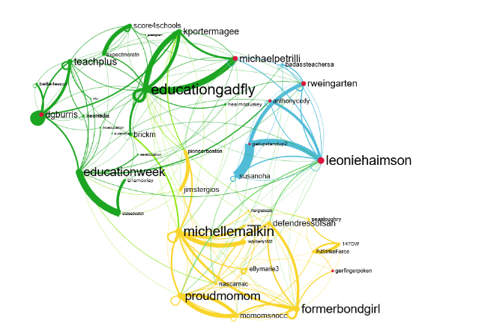
Twitter can be very effective in getting your message out to decisionmakers and potential allies
Transcenders” on twitter re Common Core
“”Transcenders” on twitter re #CommonCore from http://www.hashtagcommoncore.com

Slide 16
In 2012 Gates Foundation got into the business of data collection and sharing
They launched a project called the Shared Learning Collaborative with more than $100 million
Designed to collect personal information of public school students – to format data & share with for-profit data-mining software companies for the purpose of outsourcing evaluation, instruction and assessment
Detailed personal data to include student names, addresses, grades, test scores, detailed disciplinary and disability information and more.
in March 2013 the SLC spun off as a separate corporation inBloom Inc. – with 9 states and districts including NYC

Slide 17
In little over 13 months, inBloom collapsed
How did this happen? Leonie started blogging about it as did Diane Ravitch
She finally got one national reporter to write about it
Parents in the 9 states and districts partnering with inBloom protested to their school boards, legislatures and State Commissioners and one by one cancelled their contracts
NYS last to pull out as legislature passed a law against in March 214
In April 2014, and shortly after, inBloom closed its doors.

Slide 18

Parent-led #protect our schools rallies in NYC schools in 2015 generated lots of news stories

Slide 19

More recent successful Parent Led Campaign
Make Space for Quality Schools in Sunset Park
Notes:
Protect our schools After cutting school funding sharply in recent years, Governor Cuomo has threatened to hold any increase in state aid hostage to an arsenal of damaging education proposals, which could severely threaten the quality and local autonomy of NYC public schools.
campaign led by Sunset Park neighbors and community organizations whose mission is to ensure that schools in Sunset Park are built as soon as possible and where the need exists: in uncompromising locations without sacrificing necessary components for a sound educational foundation. We believe that the voices of Sunset Park's neighbors need to be included and that their active participation in the site selection process is essential.

Slide 20
What contributed to Success of these Campaigns?
Great logo and visual image aligned with message
Allowed parents and teachers to share and express views
Was something new!
Collaboration! Collaboration! Collaboration!

Slide 21
Lessons Learned
Don’t give up!
Be persistent and vocal
Have evidence on your side
Try something new

Slide 22
Families and Communities Make a Difference!

