Slide 1
HOW DOE’s C4E plan Does NOTHING to address class size or overcrowding in D5 and CityWide
Leonie Haimson, Class Size Matters
Oct. 16, 2014

Slide 2
CFE and C4E
In 2003, the state’s highest court concluded in the Campaign for Fiscal Equity (CFE) case that NYC kids were denied their fundamental constitutional right to an adequate education.
This was primarily because NYC class sizes were much larger than NY state averages and far larger than research shows is optimal.
In 2007, a new state law was passed, the Contracts for Excellence (C4E) that would provide NYC with extra funds on condition that the city also submit a plan to reduce class size in all grades.
Yet every year since then, class sizes have increased, and now in the early grades are the largest in 15 years!

Slide 3
Reducing class size #1 priority of parents in D5 and citywide

Slide 4
DOE’s class size reduction plan
In Nov. 2007, the DOE submitted a plan to gradually reduce average class size over five years at three different grade ranges.
In K-3, class sizes to be reduced to no more than 20 students per class, in grades 4-8 no more than 23 and HS core classes would be no more than 25 on average
Yet each year since 2008, class sizes have increased rather than decreased and are now largest in 15 years in early grades.

Slide 5
Class sizes in CSD 5 have increased in grades K-3 by 10.6% since 2006 and are now above Contracts for Excellence goals
Data sources: DOE Class Size Reports 2006-2013, 2008 DOE Contracts for Excellence Approved Plan

Slide 6
Class sizes city-wide have increased in core HS classes as well, by 2.3% since 2007, though the DOE data is unreliable*
*DOE’s class size data is unreliable &
their methodology for calculating HS averages have changed year to year
Data sources: DOE Class Size Reports 2006-2013, 2008 DOE Contracts for Excellence Approved Plan

Slide 7
D5 schools w/ large class sizes, grades K-3
(data source: DOE class size reports Nov. 2013 )

Slide 8
Why? Because DOE has cut back school budgets by 14% since 2007
In the state C4E law, says these funds must “supplement not supplant” city funds.
This means that the DOE could not cut back its own funding to schools when the state increased its funding. But this is what happened, starting the first year of C4E.
This year, in its C4E plan, for the first time DOE admits allowing supplanting – but also claims that the State Education Dept. has given its permission for this to occur.
“Expenditures made using C4E funds must ‘supplement, not supplant”’ funding provided by the school district; however, SED has provided guidance explaining that certain expenditures may be paid for with C4E funds even though these programs or expenditures were originally or have been typically paid for by the district or by other grants.”

Slide 10
Other ways city has encouraged class size increases
In 2010, the DOE eliminated the early grade class size reduction funding for K-3, despite promising to keep it as part of its C4E plan.
In 2011, the DOE refused to comply with a side agreement with the UFT to cap class sizes at 28 in grades 1-3, leading to sharp increases in these grades to 30 or more.
Co-locations have made overcrowding worse, and taken space that instead could have been used to reduce class size.
When principals try to lower class size, particularly in middle or high schools, DOE often sends them more students.

Slide 11
Co-locations: impact on space quite severe
Many schools in D5 and elsewhere overcrowded.
Co-locations have made overcrowding worse, and taken space that instead could have been used to reduce class size.
Charter co-locations in many instances have eliminated preKs, art and music rooms, access to libraries and gyms.
They have taken away rooms needed for special education/intervention services.

Slide 12
Case study: impact of Harlem Success 4 on PS 241
PS 241 had to give up preK, & phase out middle school grades
Lost their art room, and a science room, occupational/physical therapists forced to give services in hallways.
Left with ½ size room and ¼ size room for speech therapist, ESL teacher, and intervention specialists – though 27% students had disabilities and 26% ELLs.
Meanwhile, Harlem Success 4 had 6 cluster rooms, including 3 science labs, art room, dance studio, and block room, and speech room (only used 2 days per week)

Slide 13
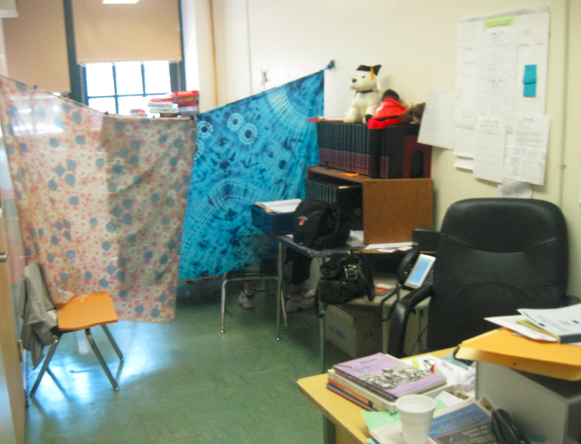
PTA office/speech therapy room at PS/MS 149 – space squeezed by Success charter expansion

Slide 14

Room taken by Success charter from PS 175 now sitting empty

Slide 15
More ways DOE has worked to increase class size in its C4E plan
DOE refuses to allocate any funds specifically towards class size reduction in its targeted or citywide C4E allocations.
DOE allows principals to use C4E funds to “Minimize growth of class size,” which is not class size reduction.
DOE has never aligned its capital plan or the school utilization formula to smaller classes, contrary to the C4E law.

Slide 16
Overcrowding in D5 and Manhattan
Last year there were 5 District 5 buildings with elementary and middle school students that were over 100% utilization.
17 Manhattan high school buildings were over-utilized.
Most experts believe that these figures underestimate the actual level of overcrowding in our schools; and so Chancellor has appointed a task force to revamp the Blue Book formula.
Yet there are NO seats for D5 or for Manhattan HS in the capital plan.
Source: 2013-2014 DOE Blue Book

Slide 17
7 D5 ES and MS Buildings are over-utilized
598 Seats Needed to reach 100% building utilization
Source: 2013-2014 DOE Blue Book

Slide 18
18 Manhattan HS buildings are over-utilized
3,548 Seats Needed to reach 100% building utilization
Source: 2012-2013 DOE Blue Book

Slide 19
City-wide Enrollment Projections K-8 vs. New Seats in Capital Plan
*Statistical Forecasting does not include D75 students; K-8 Seats in Capital Plan are categorized as Small PS and PS/IS and includes 4,900 seats for class size reduction if Bond issue passes.
Source for Housing Starts: NYSCA Projected New Housing Starts 2012-2021, http://www.nycsca.org/Community/CapitalPlanManagementReportsData/Housing/2012-21HousingWebChart.pdf; Projected public school ratio, https://data.cityofnewyork.us/Education/Projected-Public-School-Ratio/n7ta-pz8k

Slide 20
City-wide Enrollment Projections HS vs. New Seats in Capital Plan
*Statistical Forecasting does not include D75 students; HS Seats in Capital Plan are categorized as IS/HS and does not include seats for class size reduction
Source for Housing Starts: NYSCA Projected New Housing Starts 2012-2021, http://www.nycsca.org/Community/CapitalPlanManagementReportsData/Housing/2012-21HousingWebChart.pdf; Projected public school ratio, https://data.cityofnewyork.us/Education/Projected-Public-School-Ratio/n7ta-pz8k

Slide 21
Bill de Blasio promised to reduce class size while running for Mayor
During his campaign, Mayor de Blasio promised if elected to abide by the city’s original class size plan approved by the state in 2007.
The Mayor needs to deliver on his promise and provide what NYC parents want and their children need.
He also needs to expand the capital plan to alleviate school overcrowding, end ALL co-locations, and build more schools!

Slide 22
Comparison of class sizes in Blue book compared to current averages & Contract for excellence goals
Grade levels | UFT Contract class size limits | Target class sizes in "blue book" | Current average class sizes | C4E class Size goals | How many students allowed in 500 Sq ft classroom according to NYC building code
Kindergarten | 25 | 20 | 23 | 19.9 | 14
1st-3rd | 32 | 20 | 25.5 | 19.9 | 25
4th-5th | 32 | 28 | 26 | 22.9 | 25
6th-8th | 30 (Title I) 33 (non-Title I) | 28 | 27.4 | 22.9 | 25
HS (core classes) | 34 | 30 | 26.7* | 24.5 | 25
*DOE reported HS class sizes unreliable

