Slide 1
HOw DOE’s C4E plan violates the language and intent of the law
Presentation for Community Education Council 30
Leonie Haimson, Class Size Matters
Oct. 16, 2014

Slide 2
CFE and C4E
In 2003, the state’s highest court concluded in the Campaign for Fiscal Equity (CFE) case that NYC kids were denied their fundamental constitutional right to an adequate education.
This was primarily because NYC class sizes were much larger than NY state averages and far larger than research shows is optimal.
In 2007, a new state law was passed, the Contracts for Excellence (C4E) that would provide NYC with extra funds on condition that the city also submit a plan to reduce class size in all grades.
Yet every year since then, class sizes have increased, and now in the early grades are the largest in 15 years!

Slide 3
Reducing class size top priority of parents citywide and #2 in D30

Slide 4
DOE’s class size reduction plan
In Nov. 2007, the DOE submitted a plan to gradually reduce average class size over five years at three different grade ranges.
In K-3, class sizes to be reduced to no more than 20 students per class, in grades 4-8 no more than 23 and HS core classes would be no more than 25 on average
Yet each year since 2008, class sizes have increased rather than decreased and are now largest in 15 years in early grades.

Slide 5
Class sizes in D30 have increased in grades K-3 by 21.5% since 2007 and are now far above C4E goals
Data sources: DOE Class Size Reports 2006-2013, 2008 DOE Contracts for Excellence Approved Plan

Slide 6
D30’s class sizes in grades 4-8 have increased by 7.3% since 2007 and are now far above C4E goals
Data sources: DOE Class Size Reports 2006-2013, 2008 DOE Contracts for Excellence Approved Plan

Slide 7
Class sizes city-wide have increased in core HS classes as well, by 2.3% since 2007, though the DOE data is unreliable*
*DOE’s class size data is unreliable &
their methodology for calculating HS averages have changed year to year
Data sources: DOE Class Size Reports 2006-2013, 2008 DOE Contracts for Excellence Approved Plan

Slide 8
Examples of schools in D30 with large class sizes, K-3 in 2013-14

Slide 9
Why? Because DOE has cut back school budgets by 14% since 2007
In the state C4E law, says these funds must “supplement not supplant” city funds.
This means that the DOE could not cut back its own funding to schools when the state increased its funding. But this is what happened, starting the first year of C4E.
This year, in its C4E plan, for the first time DOE admits allowing supplanting – but also claims that the State Education Dept. is giving its permission for this to occur.
“Expenditures made using C4E funds must ‘supplement, not supplant”’ funding provided by the school district; however, SED has provided guidance explaining that certain expenditures may be paid for with C4E funds even though these programs or expenditures were originally or have been typically paid for by the district or by other grants.”

Slide 11
Other ways city has encouraged class size increases
In 2010, the DOE eliminated the early grade class size reduction funding for K-3, despite promising to keep it as part of its C4E plan.
In 2011, the DOE refused to comply with a side agreement with the UFT to cap class sizes at 28 in grades 1-3, leading to sharp increases in these grades to 30 or more.
Co-locations have made overcrowding worse, and taken space that instead could have been used to reduce class size.
When principals try to lower class size, particularly in middle or high schools, DOE often sends them more students.

Slide 12
More ways DOE has worked to increase class size in its C4E plan
DOE refuses to allocate any funds specifically towards class size reduction in its targeted allocations.
DOE allows principals to use C4E funds to “Minimize growth of class size,” which is not class size reduction.
DOE has never aligned its capital plan or the school utilization formula to smaller classes, contrary to the C4E law.

Slide 13
Average Utilization Rates in D30 compared to City-Wide 2012-2013
*Calculated by dividing building enrollment by the target capacity
Source: 2012-2013 DOE Blue Book
1,476 ES seats and 7,295 HS Seats needed to reach 100% building utilization

Slide 14
Overcrowding worsening in D30 schools
District 30 Elementary schools averaged 108% utilization, an increase from the year before.
774 students were in trailers or TCUs
300 students in a mini-school (P.S. 11) and 244 students in an Annex (P.S. 150)
Elementary schools would register even more overcrowded if DOE formula aligned to smaller classes & sufficient cluster rooms and dedicated spaces for special ed services.
Data from 2013-2014 Blue Book

Slide 15
Overcrowding in D30 and Queens
Last year there were 21 District 30 buildings with elementary and middle school students that were over-100% utilization – more than year before.
29 Queens high school buildings were over-utilized.
Most experts believe that these figures underestimate the actual level of overcrowding in our schools; and so Chancellor has appointed a task force to revamp the Blue Book formula.
DOE consultants project 170-5,200 new D30 students over next 5-10 years.
Yet there are only 1000 ES & MS seats for D30 in the 5 year plan, and 2,208 Queens HS seats although they identified a seat need of 5,604
Source: 2013-2014 DOE Blue Book

Slide 16
27 ES and MS Buildings in D30 are over-utilized 3,078 ES and MS Seats needed to reach 100% building utilization
3,078 ES and MS Seats needed to reach 100% building utilization; PS 92, PS 127 and PS 228 are in CM District 21

Slide 17
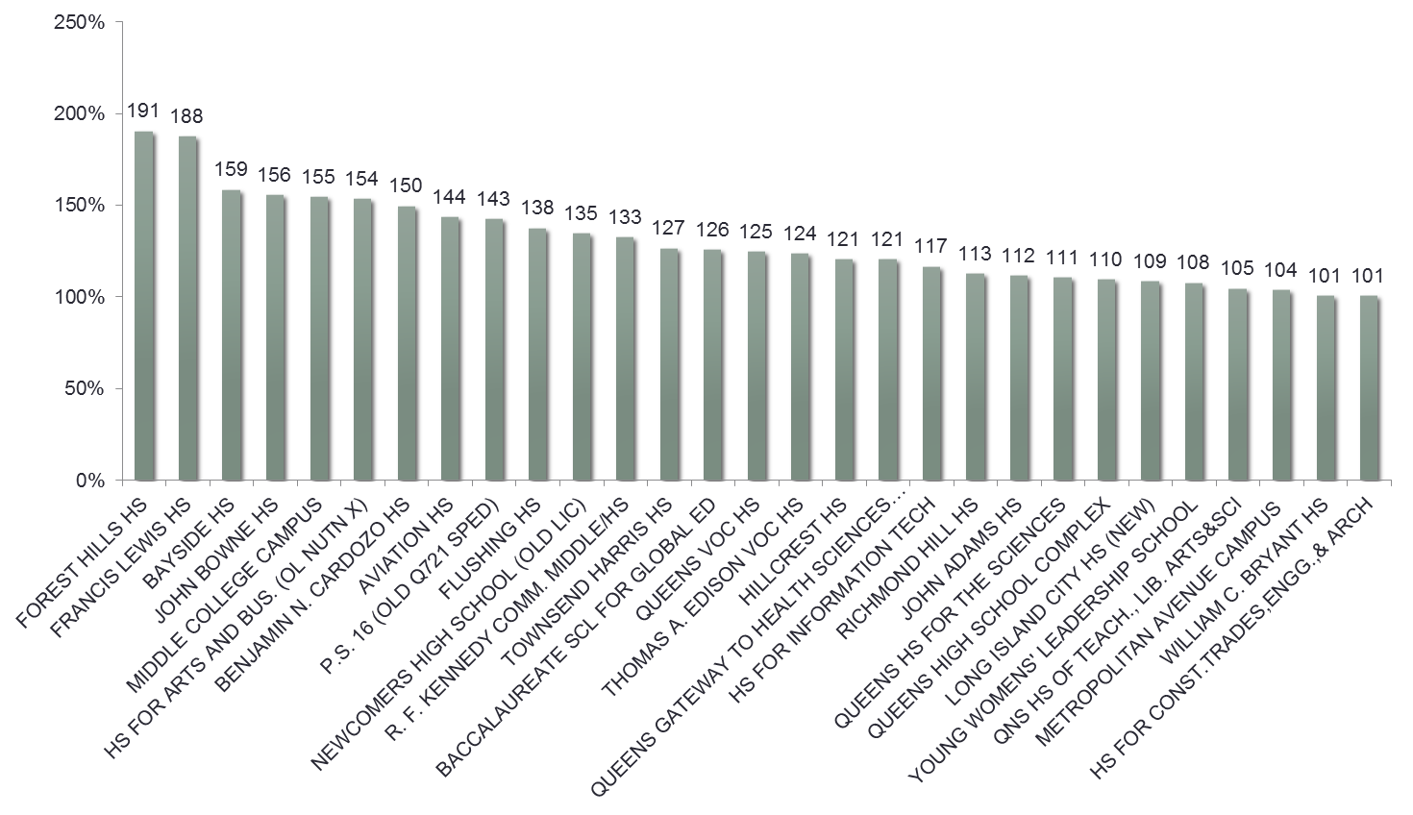
29 Queens High School Buildings are over-utilized

Slide 18
New Seats in Capital Plan and DOE Enrollment Projections for CSD 30
Enrollment projections suggest increase of 4,290 to 5,450 new students by 2021

Slide 19
City-wide Enrollment Projections K-8 vs. New Seats in Capital Plan
*Statistical Forecasting does not include D75 students; K-8 Seats in Capital Plan are categorized as Small PS and PS/IS and includes 4,900 seats for class size reduction if Bond issue passes.
Source for Housing Starts: NYSCA Projected New Housing Starts 2012-2021, http://www.nycsca.org/Community/CapitalPlanManagementReportsData/Housing/2012-21HousingWebChart.pdf; Projected public school ratio, https://data.cityofnewyork.us/Education/Projected-Public-School-Ratio/n7ta-pz8k

Slide 20
City-wide Enrollment Projections HS vs. New Seats in Capital Plan
*Statistical Forecasting does not include D75 students; HS Seats in Capital Plan are categorized as IS/HS and does not include seats for class size reduction
Source for Housing Starts: NYSCA Projected New Housing Starts 2012-2021, http://www.nycsca.org/Community/CapitalPlanManagementReportsData/Housing/2012-21HousingWebChart.pdf; Projected public school ratio, https://data.cityofnewyork.us/Education/Projected-Public-School-Ratio/n7ta-pz8k

Slide 21
Bill de Blasio promised to reduce class size while running for Mayor
During his campaign, Mayor de Blasio promised if elected to abide by the city’s original class size plan approved by the state in 2007.
The Mayor needs to deliver on his promise and provide what NYC parents want and their children need.
He also needs to expand the capital plan to alleviate school overcrowding, end ALL co-locations, and build more schools!

Slide 22
How can you help?
Sign up for the Class Size Matters newsletter.
Meet with your City Councilmembers (Julissa Ferreras, Costa Constantinides, Daniel Dromm, James G. Van Bramer) and urge them to expand the capital plan and end all future co-locations.
Be pro-active about fighting for your children to receive their constitutional right to a sound basic education, including lowering class size.
Any questions, please email us at info@classsizematters.org

Slide 23
Comparison of class sizes in Blue book compared to current averages & Contract for excellence goals
Grade levels | UFT Contract class size limits | Target class sizes in "blue book" | Current average class sizes | C4E class Size goals | How many students allowed in 500 Sq ft classroom according to NYC building code
Kindergarten | 25 | 20 | 23 | 19.9 | 14
1st-3rd | 32 | 20 | 25.5 | 19.9 | 25
4th-5th | 32 | 28 | 26 | 22.9 | 25
6th-8th | 30 (Title I) 33 (non-Title I) | 28 | 27.4 | 22.9 | 25
HS (core classes) | 34 | 30 | 26.7* | 24.5 | 25
*DOE reported HS class sizes unreliable

