Slide 1
Impact of Charters and Co-Locations on NYC Public Schools
CEC District 5 presentation
Leonie Haimson, Class Size Matters
October 8, 2014

Slide 2
As charters inundate NYC & District 5, draw enrollment from local public schools
As school budgets tied to enrollment, their budgets shrink each year, leading to larger class sizes & fewer services.
Since charters enroll fewer at risk students, the most at-risk kids are concentrated in public schools, with less funding, larger classes and fewer services.
Charter co-locations also take up valuable space, that otherwise could be used for smaller classes, cluster rooms, or special ed/intervention services.
NYC spent MORE than $1 billion last year on charters and spending rising fast.

Slide 3
At least 15 charters in D5 this year…with more to come
1. 84M350 Democracy Prep Charter School
2. 84M065 Democracy Prep Endurance Charter School
3. 84M481 Democracy Prep Harlem Charter School
4. 84M284 Harlem Children's Zone Promise Academy I Charter School
5. 84M341 Harlem Children's Zone Promise Academy II Charter School
6. 84M709 Harlem Village Academy Charter School
7. 84M335 Harlem Village Academy Leadership Charter School
8. 84M336 KIPP Infinity Charter School
9. 84M726 KIPP STAR College Prep Charter School
10. 84M100 Neighborhood Charter School of Harlem
11. 84M388 St. Hope Leadership Academy Charter School
12. 84M384 Success Academy Charter School - Harlem 2
13. 84M386 Success Academy Charter School - Harlem 4
14. 84M482 Success Academy Charter School - Harlem 5
15. Success Central Harlem Middle School (in private space paid for by city)

Slide 4
Class sizes in CSD 5 have increased in grades K-3 by 9.5% since 2008 and are now above Contracts for Excellence goals
Data sources: DOE Class Size Reports 2006-2013, 2008 DOE Contracts for Excellence Approved Plan

Slide 5
Examples of schools in CSD 5 with large class sizes, grades K-3

Slide 6
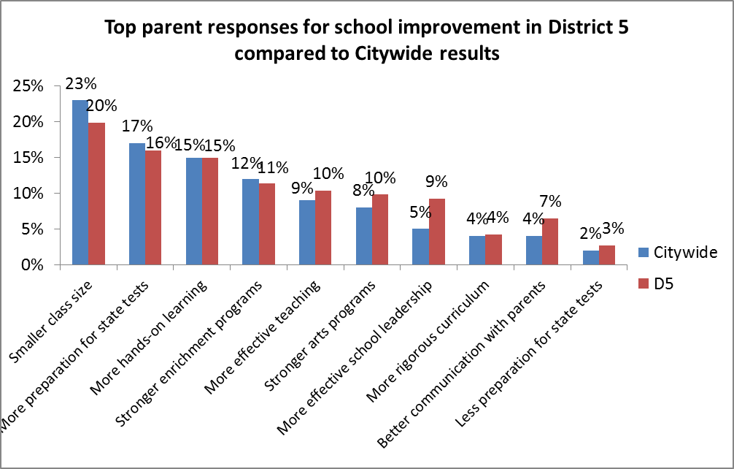
Smaller classes #1 priority for D5 parents

Slide 7
Comparative class sizes at NYC charter schools
source: analysis of NY school report cards data by
Rutgers Prof. Bruce Baker

Slide 8
FACT: Charter schools do NOT educate the same sort of students as public schools citywide.
The NYC Charter Center reports that charters enroll fewer students with disabilities and English Language Learners than the districts in which they are located.
Rutgers Prof. Bruce Baker has shown there are significantly fewer free lunch students at NYC charter schools as well.
Charters have FAR fewer students with serious disabilities than enrolled in NYC public schools .

Slide 9
NYC charter students vs. public schools
Data analysis by Prof. Bruce Baker from NY school report cards

Slide 10
District 5 schools have nearly three times the percent of English language learners as charters in the district
From DOE school progress report data

Slide 11
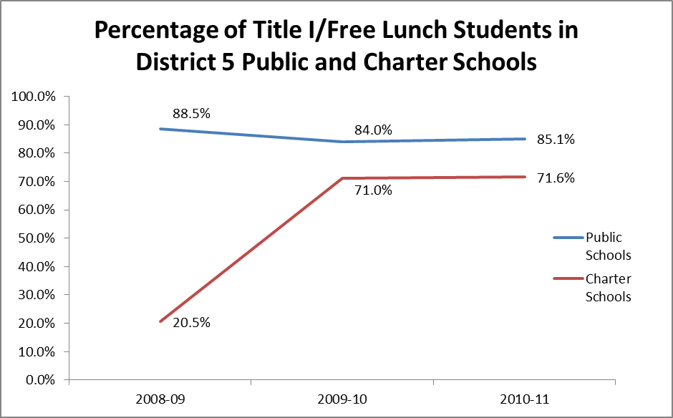
D5 public schools have substantially more students in poverty than D5 charters
From DOE school progress report data

Slide 12
District 5 public schools have substantially more students of higher need than D5 charters
(based on DOE “peer” formula)
From DOE school progress report data

Slide 13
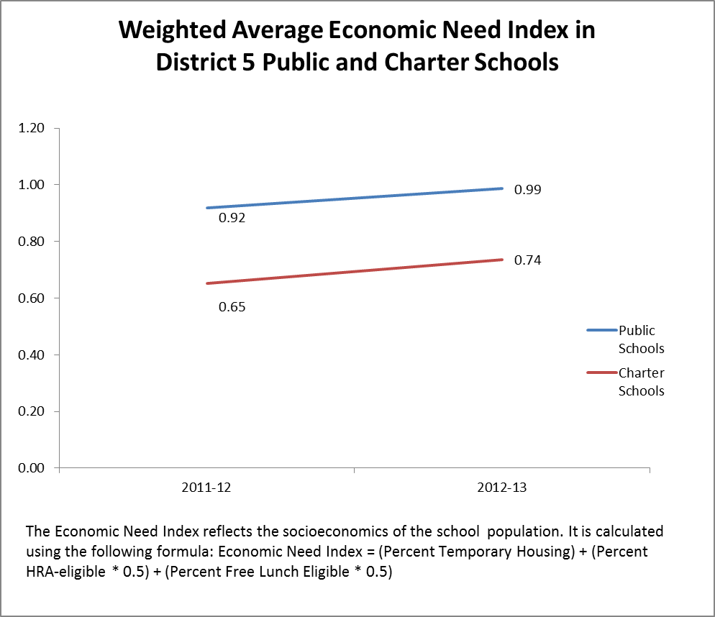
District 5 public schools have far more students in economic need (based on income, homelessness, and eligibility for HR assistance)
From DOE school progress report data

Slide 14
District 5 schools have substantially more students with disabilities
From DOE school progress report data

Slide 15
Students with highest level of disabilities
Citywide, public schools enroll 9.4% students with the highest level of disabilities.
In Harlem public schools, 14% are students with the highest level of disabilities
At Harlem Success charters only 17 out of 2540 students had the highest level of disabilities – less than 1%, and 15 times lower than in rest of Harlem.

Slide 16
FACT: Charters are NOT public schools
Charter schools are publicly funded but run by corporate boards, and do NOT have to follow the same laws or rules that public schools do.*
Charters are not governed by any democratically elected body, often enact extreme disciplinary policies, and usually exhibit high suspension and student attrition rates.
Charters can expel students – and Success Academy does; not allowed in ANY NYC public school for students under 17 according to Chancellor’s regulations .
*NY State law: A charter school shall be exempt from all other state and local laws, rules, regulations or policies governing public or private schools, boards of education [and], school districts and political subdivisions, including those relating to school personnel and students, except as specifically provided in the school's charter or in this article.

Slide 17
Charter schools are NOT public schools Part II
Charters can set their enrollment and class sizes at ANY level they want.
They can admit students only in the fall and do not have to take students mid-year -- or in any grade other than they want.
They can set rigid academic, behavior and cultural standards that promote exclusion/suspension/attrition of students.
Charter schools have also used their private status to evade federal constitutional and statutory protections for employees and students.

Slide 18
Suspension rates of Success Academy charters
Data analysis by Daily News from NY report card data

Slide 19
Co-locations: impact on space quite severe
Many schools in D5 and elsewhere overcrowded.
Charter co-locations in many instances have eliminated preKs, art and music rooms, access to libraries and gyms.
They have taken away rooms needed for special education/intervention services.

Slide 20
Average Utilization Rates in CSD 5 at 92.3% -- would be OVER 100% if formula were improved to take into account what kids need for a sound basic education
*Calculated by dividing building enrollment by the target capacity
Source: 2012-2013 DOE Blue Book

Slide 22
Case study: impact of Harlem Success 4 on PS 241
PS 241 had to give up preK, & phase out middle school grades
Lost their art room, and a science room, occupational/physical therapists forced to give services in hallways.
Left with ½ size room and ¼ size room for speech therapist, ESL teacher, and intervention specialists – though 27% students had disabilities and 26% ELLs.
Meanwhile, Harlem Success 4 had 6 cluster rooms, including 3 science labs, art room, dance studio, and block room, and speech room (only used 2 days per week)

Slide 23
PTA office/speech therapy room at PS/MS 149

Slide 24
FACT: most NYC charters get more public funding per student
IBO showed that co-located charters get MORE per student public funding when free space & services taken into account.
Analysis did not include “fair student funding” tied funds in public schools but NOT charters to category of student need, so that charters are favored, considering low comparative level of student need.
Analysis did not include charter school students twice as likely to get free busing at city expense.
Analysis did not include private funding for charters that can run into the millions of dollars.
Did not include new law: additional $500 per charter student over 3 yrs and rent for new NYC charters at $2,775 per student per year.

Slide 25
New charter provisions passed in state budget
Any charter co-located in a NYC school building cannot be evicted and has veto powers before leaving the building – even if they are expanding and squeezing out NYC public school students.
This includes any charter co-location agreed to d before Bloomberg left office.
Any new or charter school in NYC adding grade levels must be “provided access to facilities” within five months of request or provided $2700 per student for rent.
If they don’t like the space offered can appeal to NY State Ed Commissioner King, a former charter school director.
After the city spends $40 M per year on charter rent, the state will begin chipping in 60% of additional cost.
In addition, the state granted all charter schools with per-pupil funding increases, amounting to $500 over the next 3 years .

Slide 26
City paying $5.5M this year for 3 Success Charters
NYC spending $5.46 million this year for three school buildings for Success Academy, two in Manhattan, and one in Queens.
$3.2M per year –or $18,000 in rent for every student -- for Success Academy Washington Heights in former Mother Cabrini High School.
Also paying rent for Success Academy Harlem Central Middle School for the former Annunciation School on W. 131 St in District 5 .
Also rent for Success Academy Jamaica, for the former St. Pius X School in Rosedale Queens.
2 Manhattan schools at $39 per sq. ft. compared to market $24 - $27 sq. foot for comparable space.
These costs do NOT Include renovations, which city is also paying for, and rents will rise over time.

Slide 27
Next steps?
URGE Mayor and Chancellor to STOP all new co-locations until utilization formula has been improved & all our schools have smaller classes.
Ask Gov. and Legislators to amend law so that NY STATE not NYC pays for charter school rent.
ORGANIZE against raising of charter cap which the Wall St./hedgefunders/charter lobby is now pushing for.
DEMAND that State and City properly fund our schools.

