Slide 1
Why DOE’s C4E plan violates the language and intent of the law
Karen Sprowal, Class Size Matters
Oct. 2, 2014

Slide 2
CFE and C4E
In 2003, the state’s highest court concluded in the Campaign for Fiscal Equity (CFE) case that NYC kids were denied their fundamental constitutional right to an adequate education.
Primarily because their class sizes were much larger than NY state averages.
In 2007, a new state law was passed, the Contracts for Excellence (C4E) that would provide NYC with extra funds on the condition that the city also submit a plan to reduce class size in all grades.
Yet every year since then, class sizes have increased, and now in the early grades are the largest in 15 years!

Slide 3
DOE’s class size reduction plan
In Nov. 2007, the DOE submitted a plan to gradually reduce average class size over five years at three different grade ranges.
In K-3, class sizes would be reduced to no more than 20, in grades 4-8 no more than 23 and HS core classes would be no more than 25 on average
Instead, class size has risen every year since then.

Slide 4
Class sizes citywide and CSD 28 have increased in grades K-3 by 21.4% since 2006, the largest in 15 years citywide
Data sources: DOE Class Size Reports 2006-2013, 2008 DOE Contracts for Excellence Approved Plan

Slide 5
CSD 28’s class sizes in grades 4-8 have increased by 12.6% since 2007 far above Contracts for Excellence goals
Data sources: DOE Class Size Reports 2006-2013, 2008 DOE Contracts for Excellence Approved Plan

Slide 6
Class sizes city-wide have increased in core HS classes as well, by 2.3% since 2007, though the DOE data is unreliable*
*DOE’s class size data is unreliable &
their methodology for calculating HS averages have changed year to year
Data sources: DOE Class Size Reports 2006-2013, 2008 DOE Contracts for Excellence Approved Plan

Slide 7
D28 schools with large K-3 class sizes 2013-14

Slide 9
Why? Because DOE has cut back school budgets by 14% since 2007
In the state C4E law, says these funds must “supplement not supplant” city funds.
This means that the DOE could not cut back its own funding to schools when the state increased its funding. But this is what happened, starting the first year of C4E.
This year, in its C4E plan, for the first time DOE admits allowing supplanting – but also claims that the State Education Dept. has allowed it to happen.
“Expenditures made using C4E funds must ‘supplement, not supplant”’ funding provided by the school district; however, SED has provided guidance explaining that certain expenditures may be paid for with C4E funds even though these programs or expenditures were originally or have been typically paid for by the district or by other grants.”

Slide 10
Other ways city has encouraged class sizes to increase
In 2010, the DOE got rid of the early grade class size reduction program, despite promising to keep it as part of its C4E plan.
In 2011, the DOE got rid of its UFT agreement to cap class sizes at 28 in grades 1-3, leading to sharp increases to 32 or more.
Co-locations have made overcrowding worse, and taken space that instead could have been used to reduce class size. Throughout, when principals try to reduce class size, DOE often sends them more students.

Slide 11
More ways DOE has worked to increase class size
When principals try to lower class size, particularly in middle or high schools, DOE often sends them more students.
DOE refuses to allocate any funds specifically towards class size reduction.
Allows principals to use C4E funds to Minimize growth of class size
As a result, more than 330,000 students attended classes of 30 or larger last year.

Slide 12
School overcrowding
According to the C4E regulations, DOE was supposed to align its capital plan with its class size reduction plan.
This never happened, and there is now worse school overcrowding than in 2007, particularly in elementary and middle schools.
The capital plan has never been fully funded
Blue Book’s school utilization formula aligned with large class sizes ( 28 students per class in 4th -8th grade, and 30 in high school) and thus will push class sizes even higher in these grades.

Slide 13
School Utilization Rates at critical levels
Schools have become more overcrowded over last six years. More than 480,000 students citywide are in extremely overcrowded buildings.
D28 Elementary schools 98% on AVERAGE – middle schools 94.5%, both above citywide average.
Queens high school buildings have avg. utilization rate of 110.7%.
Data source: Blue Book target utilization rates 2012-2013

Slide 14
Average Utilization Rates in CSD 28 compared to City-Wide 2012-2013
D28 ES building utilization rate at 98%, above citywide average
*Calculated by dividing building enrollment by the target capacity
Source: 2012-2013 DOE Blue Book
7,295 HS Seats in Queens needed to reach 100% building utilization

Slide 15
Over-utilized ES and MS buildings in CSD 28 and Queens HS
There are 25 elementary & middle school buildings in CSD 28 that are 100% utilization or higher.
The seats need in these schools is over 1,600 students.
There are 29 over-utilized Queens HS buildings with a seats need for more than 13,000 students.

Slide 16
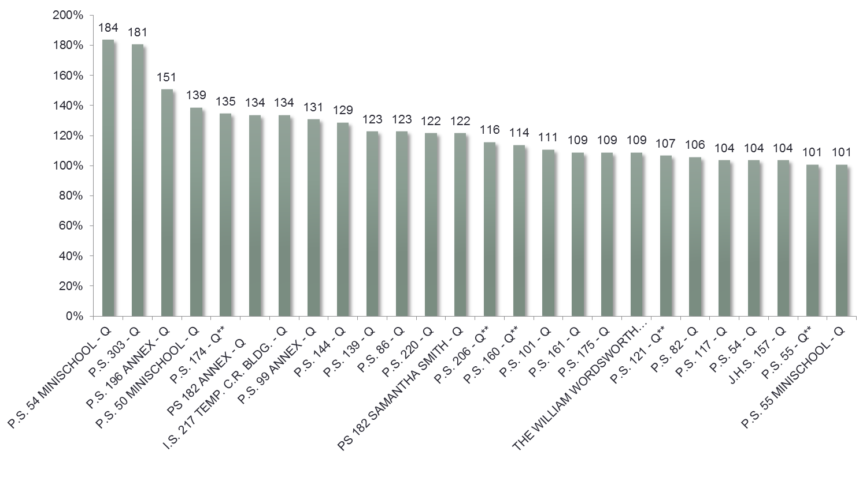
25 CSD 28 ES and MS buildings are over-utilized

Slide 17
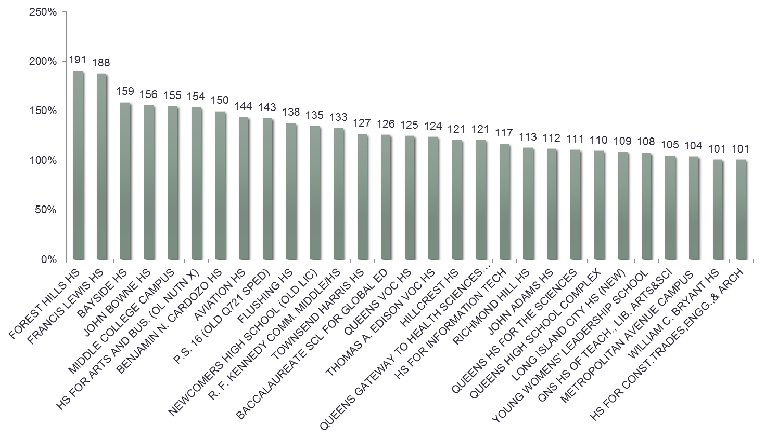
29 Queens High School Buildings are over-utilized

Slide 18
Only 640 seats in capital plan for D28 despite enrollment projections of more than 3,000
~3,033 to 3,281 new students by 2021 according to enrollment projections but only 640 seats are being added.

Slide 19
Number of students in CSD 28 trailers
In 2012-2013 according to DOE, there were at least 241 D28 elementary and middle school students in trailers.
There were 23 TCUs at eight schools: PS 30*, PS 40*, PS 55, PS 121, PS 140, PS 160, PS 174*, PS 206.
Schools with asterix were listed as underutilized in 2013-2014 Blue Book.
According to Superintendent, PS 140 TCU now (2014-2015) removed.

Slide 20
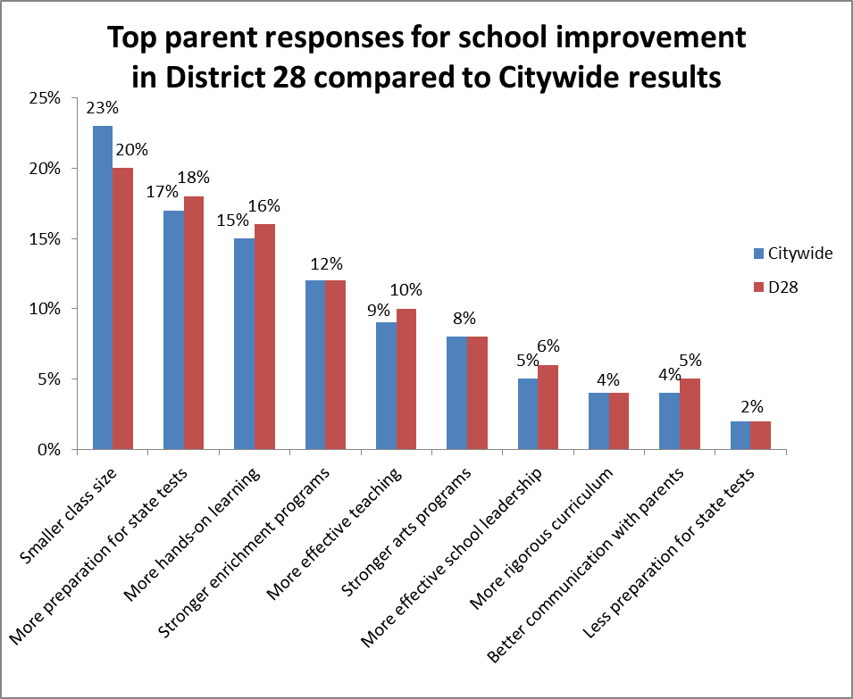
Reducing class size top priority of parents in D28 and citywide

Slide 21
Bill de Blasio promised to reduce class size while running for Mayor
During his campaign when vetted by public education parents, Mayor de Blasio promised if elected to abide by the city’s original Contracts for Excellence plan approved by the state in 2007.
Class sizes no larger than 20 students per class in grades K-3, 23 in grades 4-8, and 25 in core academic high school classes.
He also promised that if necessary, he would raise funds to do so.
The Mayor needs to deliver on his promise and provide what NYC parents want and their children need.

Slide 22
Comparison of class sizes in Blue book compared to current averages & Contract for excellence goals
Grade levels | UFT Contract class size limits | Target class sizes in "blue book" | Current average class sizes | C4E class Size goals | How many students allowed in 500 Sq ft classroom according to NYC building code
Kindergarten | 25 | 20 | 23 | 19.9 | 14
1st-3rd | 32 | 20 | 25.5 | 19.9 | 25
4th-5th | 32 | 28 | 26 | 22.9 | 25
6th-8th | 30 (Title I) 33 (non-Title I) | 28 | 27.4 | 22.9 | 25
HS (core classes) | 34 | 30 | 26.7* | 24.5 | 25
*DOE reported HS class sizes unreliable

