Slide 1
NYC class sizes increase for 6th year in row & why
by Leonie Haimson
Executive Director, Class Size Matters
11/18/13
www.classsizematters.org

Slide 4
Contracts for Excellence
In 2003, NYS Court of Appeals held that NYC class sizes too large to provide students with constitutional right to a sound basic education.
April 2007, NY State settled the Campaign for Fiscal lawsuit by passing the Contracts for Excellence (C4E) law. Legislature agreed to send billions in additional aid to NYC & other high needs school districts to be spent in six approved areas, including class size reduction.
In addition, NYC had to submit a plan to reduce class size in all grades.
In fall of 2007, NYSED approved DOE’s plan to reduce class sizes to an average of no more than 20 students per class in K-3; 23 in grades 4-8 and 25 in core HS classes over five yeas.
In return, NYS has sent more than $3 billion in C4E funds cumulatively to NYC since 2007, though funding has never reached its promised full level.

Slide 5
C4E regulations
iv) beginning in the 2008-2009 school year and continuing through the 2011-2012 school year, the city school district of the city of New York shall:
(A) establish annual class size reduction goals for each grade level targeted that will reduce class size toward the prekindergarten through grade 12 targets as prescribed by the commissioner after his/her consideration of the recommendation of an expert panel appointed by the commissioner to conduct a review of existing class size research;
(B) make measurable progress in each such school years toward achieving such targets; and
(C) not exceed such targets by the end of the 2011-2012 school year;
http://www.p12.nysed.gov/part100/pages/10013.html

Slide 6
Yet class sizes have increased sharply in grades K-3 for 6 years in a row – an increase of 19% since 2006

Slide 7
K-3 class sizes largest in Queens

Slide 8
Class sizes in Grades 4-8 have also increased 6 years in a row -- 7% since 2007
Gened, ICT & G&T
Data source: DOE class size reports

Slide 9
4th-8th gr class sizes largest on Staten I.

Slide 10
Class sizes have increased in core HS classes as well, by 4% since 2006, though the DOE data is unreliable*
*DOE’s class size data is unreliable &
their methodology for calculating HS averages have changed year to year

Slide 11
K-8 sections have declined each year since 2007

Slide 13
Loss of teachers while DOE had other priorities
Number of pedagogues (mostly teachers) has been cut by more than 5,000 since 2007, despite rising enrollment. *
Smallest #pedagogues in 2011 employed by DOE since 2003.
Largest # non-pedagogues in 2011 employed since at least 1980.
Highest % of non-pedagogues to pedagogues since 1993.
Spending on testing, contracts, consultants, and more bureaucrats have all risen sharply.
(*Data source: Office of Management Budget headcounts, through IBO)

Slide 14
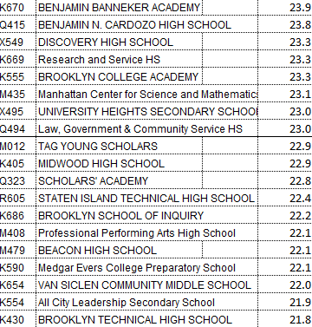
Schools with the highest student/teacher ratio

Slide 15
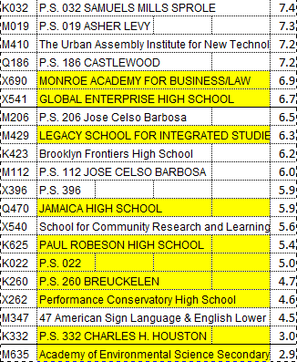
Schools with the lowest student/teacherratio
(many are phasing out)

Slide 16
WHY despite C4E law have class sizes increased?
DOE has never spent any C4E funds in their district-wide or targeted programs for class size reduction; though this was their primary legal obligation .
In 2009, DOE estimated that it would cost $358 million per year to achieve average C4E class size goals across the city;
DOE estimated it would cost $448 million per year in staffing to achieve class size goals in ALL schools; plus more in capital costs for school construction.
Each year, NYC receives more than $530 million in C4E funds.

Slide 17
Ways in which DOE policies have directly caused class size INCREASES
Since 2007, DOE has cut school budgets 14%– contradicting C4E prohibition against supplanting
In 2010, DOE eliminated Early grade class size funding for grades K-3– despite promise to state in C4E plan to maintain it
In 2011, DOE decided no longer to cap class sizes in 1st-3rd grades at 28, leading to tripling of number of classes with 30 or more students in these grades.

Slide 18
Other ways DOE has worked to increase class size
In 2012, DOE told principals to accommodate special needs students up to contractual class size maximum in gen ed & inclusion classes – 32 students per class in grades 1-5, 31 in 6-8 and 34 in HS.
DOE has never aligned its capital plan to goals in class size plan, despite this being required by C4E regs – making it impossible to reduce class size in overcrowded schools.
DOE’s removed any mention of class size standards in 2009 from instructional footprint which determine where new schools will be co-located.
Many MS and HS Principals say that when they use discretionary funds to reduce class size, DOE simply sends their school more students., undermining their efforts.

Slide 19
C4E regs re alignment with capital plan
100.13 Contract for excellence
B.1.vi “in the city school district of the City of New York, include a plan that meets the requirements of clause (c)(2)(i)(a) of this section, to reduce average class sizes within five years for the following grade ranges:
  prekindergarten through grade three;
  grades four through eight; and
  grades nine through twelve.
Such plan shall be aligned with the capital plan of the city school district of the City of New York and include continuous class size reduction for low performing and overcrowded schools beginning in the 2007-2008 school year and thereafter…”
http://www.p12.nysed.gov/part100/pages/10013.html

Slide 20
CFE funding also flat-lined; but even when increased; city’s class sizes grew!

Slide 21
Continuing violations of law re C4E public process
Despite C4E law requiring borough hearings each year, DOE has refused to hold them; CFE sued, won in State Supreme Court but city has appealed.
NYSED has been sued by CFE for setting timeline for public input in fall and winter, long after C4E funds have been allocated making accountability provisions in the law meaningless.
SED approved the city’s C4E plan for 2011-2012 in July 2013, long after all the money has been spent, making audits irrelevant.
This year SED “pre-approved” DOE’s 2013-2014 class size plan before ANY public hearings occurred – also contrary to law.

Slide 22
Inadequacies of new “pre-approved” CSR plan for 2013-2014
City is supposed to reduce or limit class size INCREASES in only 75 schools -- to half of citywide average INCREASE.
Limiting class size increases in 75 out of 1500 public schools is NOT a class size reduction plan & will NOT lead to measurably smaller classes as C4E law requires.
We took a closer look at the list of 75 schools specified by DOE for special efforts to control class size.

Slide 23
75 NYC schools pre-approved by SED for class size reduction
Nearly half (31 out of 74) are schools in good standing, rather than focus or priority schools
27% schools (20/74) have not allocated any C4E funds on class size reduction, according to DOE spreadsheet.
More than half of schools (41/74) are spending less than $100K on class size, and unable to pay for even one extra teacher.
One school (IS 23, D29) not listed at all on DOE’s C4E spreadsheet.
3 schools are phasing out (Jonathan Levin HS, JHS 302 Rafael Cordero, Business Computer Applications HS) & another is phasing out its middle school (PS 56 Laurelton)
Some principals at these schools have had their budgets cut and have not been told that they are supposed to be reducing class size.

