Slide 1
The threat to student privacy and safety represented by inBloom, Inc.
Prepared by Leonie Haimson, Class Size Matters
for the Staten Island Federation of PTAs
September 22, 2013

Slide 2
What is inBloom Inc.?
inBloom Inc. is a corporation funded with $100M by the Gates Foundation to collect and share personally identifiable student data with vendors.
The information is being uploaded onto a cloud operated by Amazon.com.
In NY State, districts told they must sign up for “data dashboards” by Sept. 27, from three vendors, ConnectEDU, eScholar or NCS Pearson/Schoolnet. that will be populated with student data from inBloom cloud.
inBloom plans to disclose this sensitive data, with state & district consent, to additional for-profit vendors, to help them develop and market their “learning products.”
Wireless Generation/Amplify, a subsidiary of Rupert Murdoch’s NewsCorp, is building inBloom’s operating system.

Slide 3
What information is being shared?
The highly sensitive data that NYS is sharing with inBloom and other vendors includes student names, addresses, phone nos., emails, grades, test scores, proficiency levels, economic, racial, disability status and disciplinary records.
The info being shared includes all your child’s records from entry into public school, including up to 12 yrs of data for HS students.
If this information leaks out or is used inappropriately this could imperil their security and safety.
It could also damage their life prospects, including chances of college admission or obtaining a job.

Slide 4
What is inBloom’s goal?
InBloom & NYS claim that this project will lead to greater efficiency, data integration, and a vibrant market in “personalized” learning tools.
Vicki Phillips of the Gates Foundation called it an “amazing” new program like a “huge app store … with the Netflix and Facebook capabilities we love the most.”
In NYC, the Department of Education spent $80M on ARIS, a data system also built by Wireless Generation. The DOE project director for ARIS, Sharren Bates, is now the COO of inBloom Inc.
The same claims were made that ARIS would improve instruction, yet it is rarely used and considered a boondoggle.

Slide 5
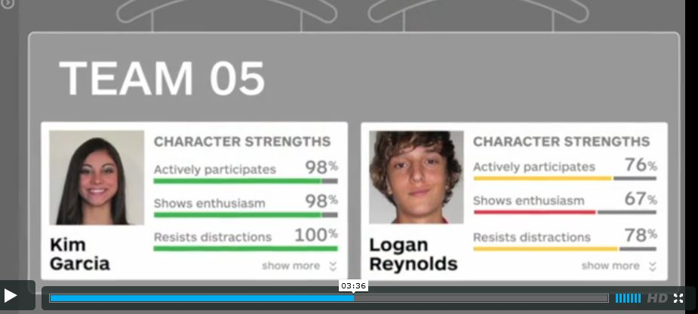
Sample dashboard from inBloom video

Slide 6
What about security?
In a recent survey, 86% of technology experts say they do not trust clouds to hold their organization’s “more sensitive” data.*
inBloom’s security policy states they “cannot guarantee the security of the information stored in inBloom or that the information will not be intercepted when it is being transmitted.”
In April, the personal information of 50 million customers of LivingSocial was inadvertently disclosed when an Amazon.com cloud was hacked into .
The sharing of personally identifiable student data with inBloom is being done without parental notification or consent.
*Lieberman Software's 2012 Cloud Security Survey

Slide 7
What about privacy?
News Corp has been found to illegally violate the privacy of individuals in the UK and the United States.
If this personal data was in a child’s health records or provided through online usage, it could NOT be shared with 3rd parties without parental consent, acc. to HIPAA (Health Insurance Portability and Accountability Act) or COPPA (Children’s Online Protection Act)
FERPA (Family Educational Rights and Privacy Act) that regulates privacy of educational records was weakened by US Dept of Ed in 2009 and 2011, to encourage data sharing with third parties.
Lawsuit in federal court filed against US Dept of Ed for rewriting FERPA regulations in way that violates intent and language of law.

Slide 8
Most inBloom states have now pulled out because of privacy concerns and protests
Five out of nine original inBloom states (NC, LA, DE, GA, and KY) announced that they will not share any student data, following protests.
After much controversy, Jefferson Co. in Colorado announced it will give parents the right to opt their child’s data out of inBloom and the data dashboards – and that NO disciplinary data will be shared.
MA is reconsidering its participation for its one pilot district, Everett.
IL is in the process of expanding its participation, but will allow districts to decide whether to share data.
New York is ONLY participant disclosing private student data from entire state with inBloom, whether districts and parents like it or not.

Slide 9
Considerable costs & risks to states/districts
Starting in 2015, inBloom says it will start charging states/ districts for its services.
Districts will be expected to pay $2-$5 per student per year, plus fees charged by data dashboard vendors, and any other software tools using data from the inBloom cloud.
If this data leaks out or is used inappropriately, the potential cost to the state and NYC of class action lawsuits is far greater, since inBloom & Gates have insulated themselves from legal liability.
inBloom says it is now also “exploring” charging vendors for its services. If not selling student data, this could be likened to renting it out.

Slide 10
Sample racial, economic, language data to be being collected by inBloom
Source: https://www.inbloom.org/sandbox

Slide 11
Sample disability & medical data collected by inBloom, Inc.
Source: https://www.inbloom.org/sandbox

Slide 12
What can parents do?
Two bills, S.5930 and S.5932, have now been introduced in NY Senate to block inBloom and give parents right to consent or opt out.
These replicate bills passed by Assembly last spring.
PLEASE contact your State Senators and urge them to sign onto these bills!
Send an email to SED, demanding to be told what data has been shared for your child and to correct if it is wrong– your right under the Personal Privacy Protection Law.
Send an email to the Chancellor, demanding the right to opt your child’s data out of disclosure to ANY vendors.
Sample letters available on our website at www.classsizematters.org

